Slide 1



Secondary Vocational School of Electrical Engineering Pilsen
15. – 21. 10. 2017

Slide 2


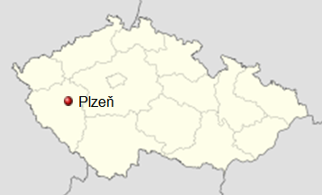
Short information about Pilsen
history: 1295 – city „New Pilsen“ was founded by Czech King Wenceslas II
nowadays: 4th biggest city in the CZR – 125 km2, 165 000 inhabitants

Slide 3
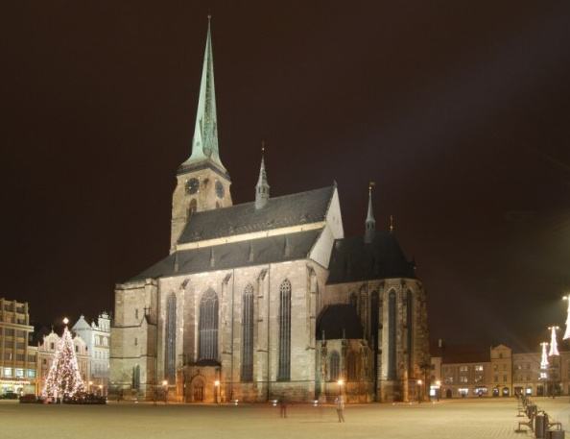
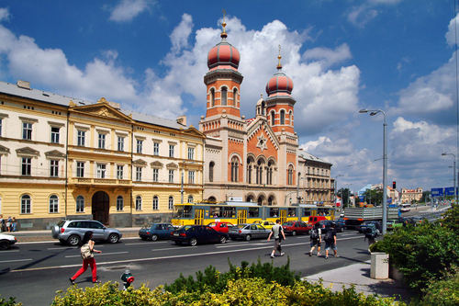
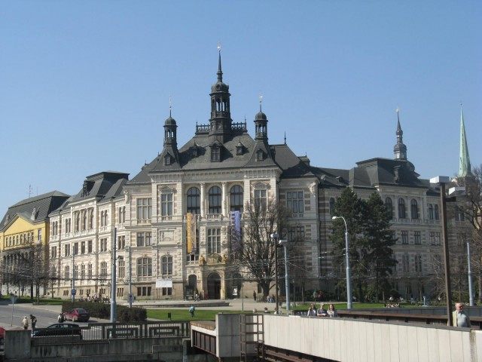
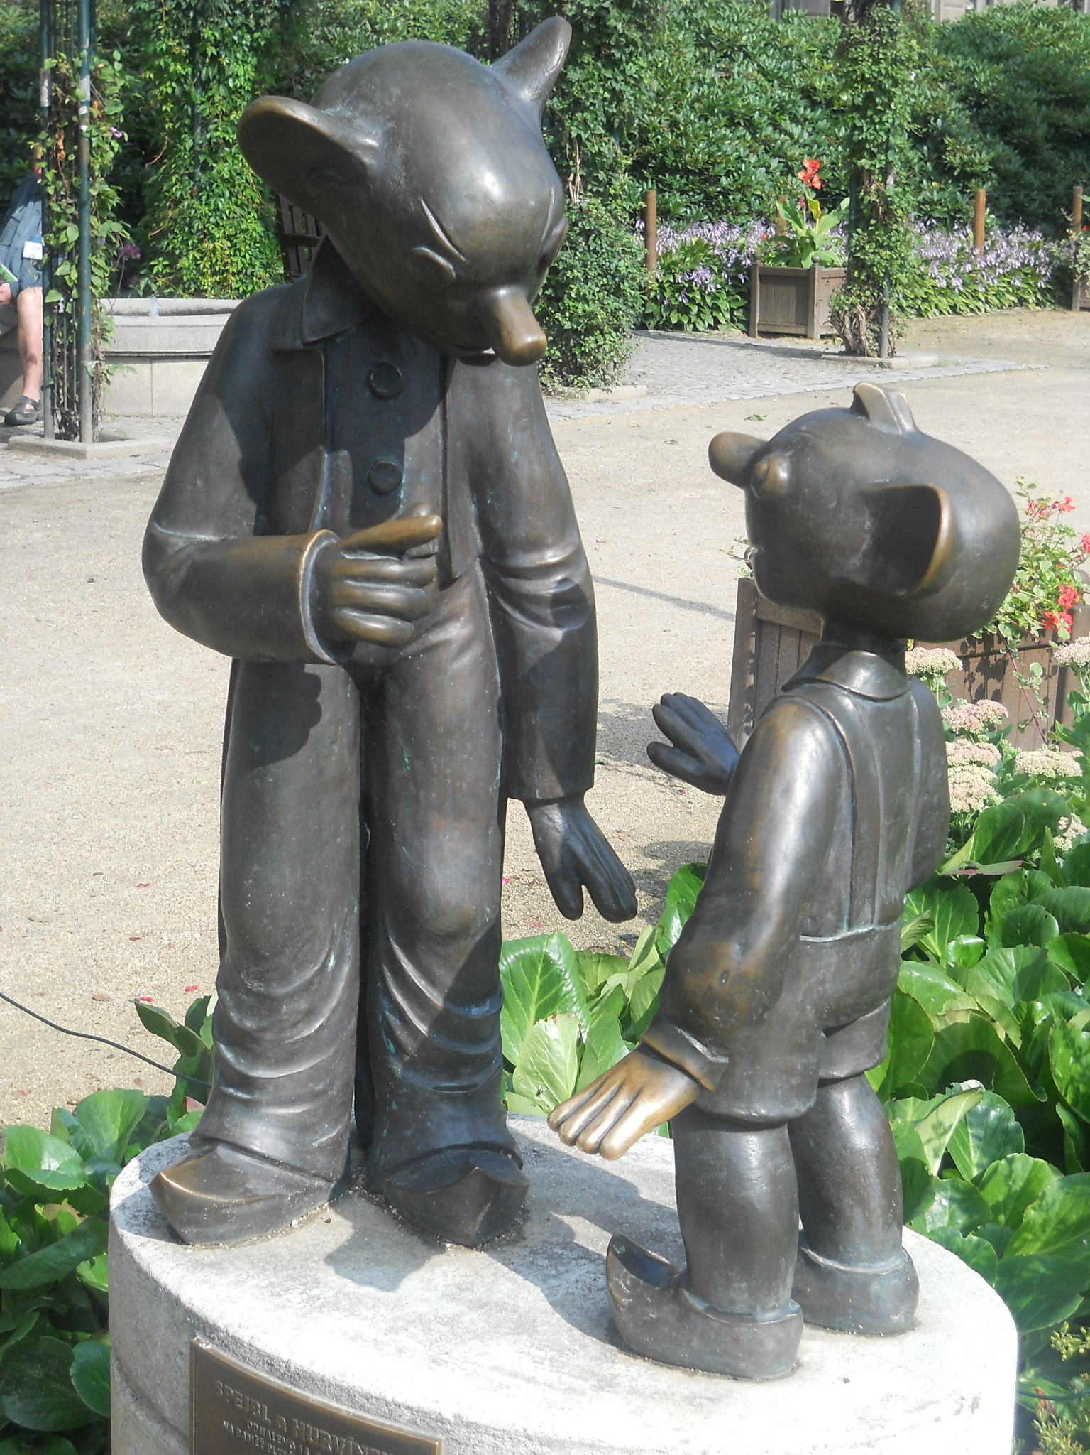
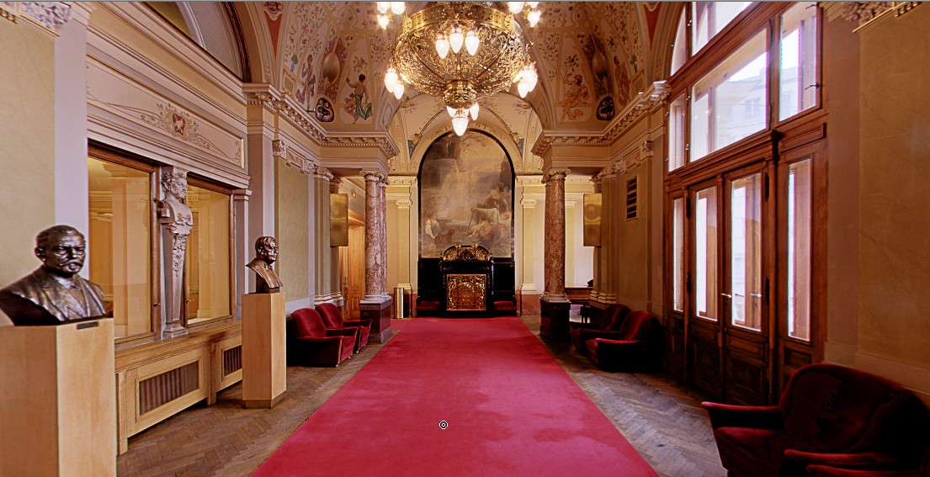
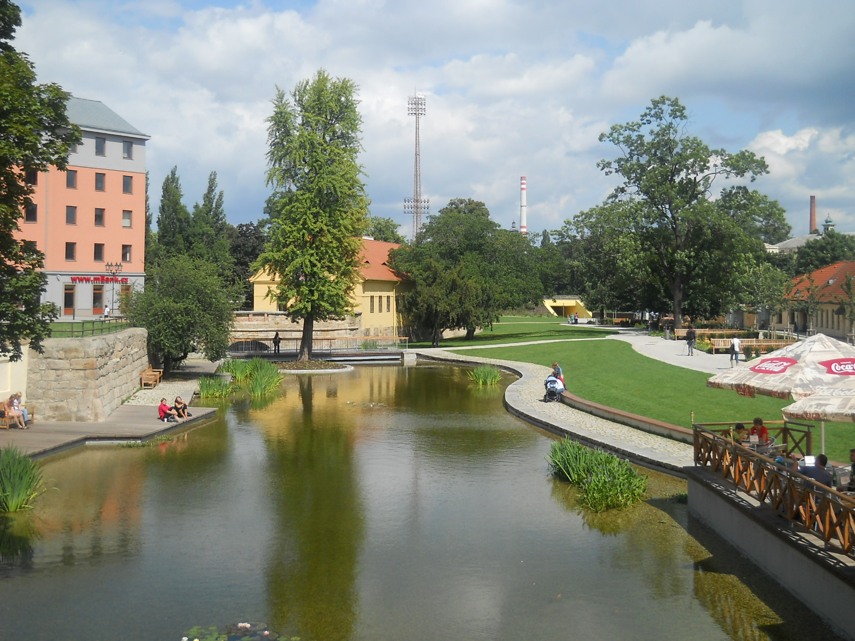

Slide 4
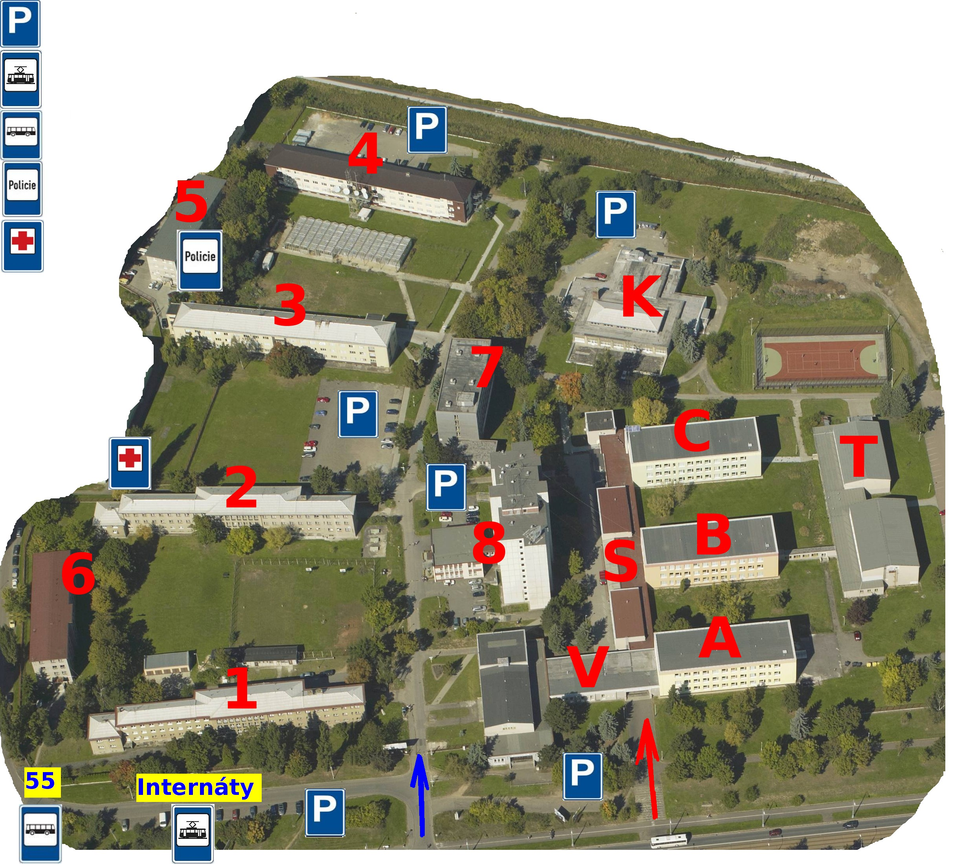
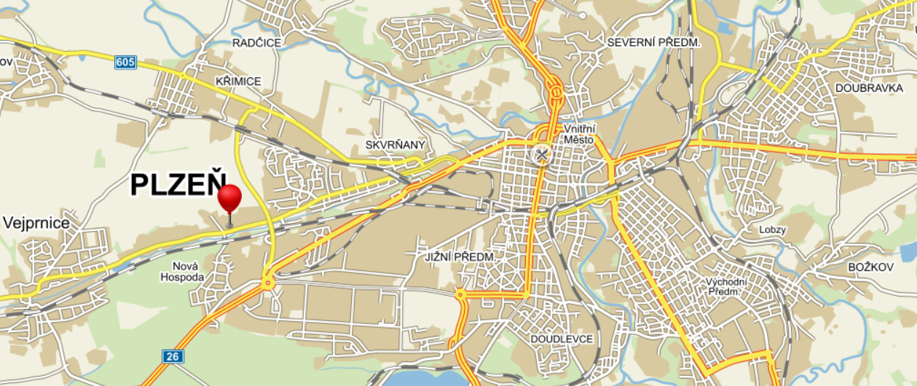
Education in Pilsen
nursery and primary schools
secondary schools
universities

Slide 5
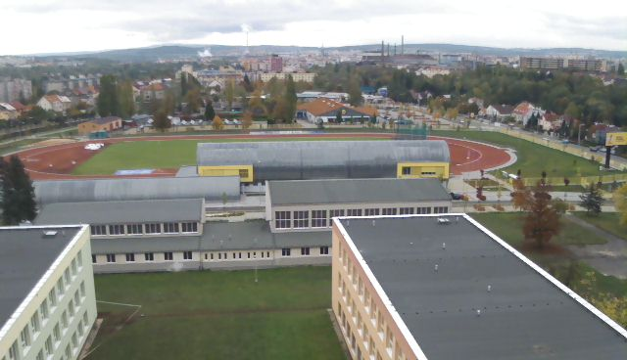
Basic information about our school
creating: 1st June 1999 by merging of 2 vocational schools
nowadays: about 800 students – the biggest secondary vocational school in Pilsen and Karlovy Vary area
140 employees, of which 90 teachers

Slide 6
What do we offer …
Secondary education (4 year study, finished by final examination)
Secondary skill training (3 year skill study finished by vocational certificate)
Electrical Mechanic for Equipment and Appliances
Electrician- Heavy Current
Electrician- Weak Current
Telecommunication
Information Technology
Mechanic of Electrical Engineering
Mechanic of Installation and Electro- Technique of Buildings

Slide 7
Other study branches
Additional, extension courses (2 or 3 year study finished by final examination)
One year distance study
(finished by vocational certificate)
Operating Electro - Technique (distance study)
Electro.-Engineering (daily study)
Electrician

Slide 8
Our activities
teaching of general and vocational subjects
professional training – practice in companies
vocational excursion of students and teachers into companies in the Czech Republic and abroad
Brush Sem s.r.o., BMW Regensburg, ETD Transformátory a.s., Kopos Kolín a.s., etc.

Slide 9
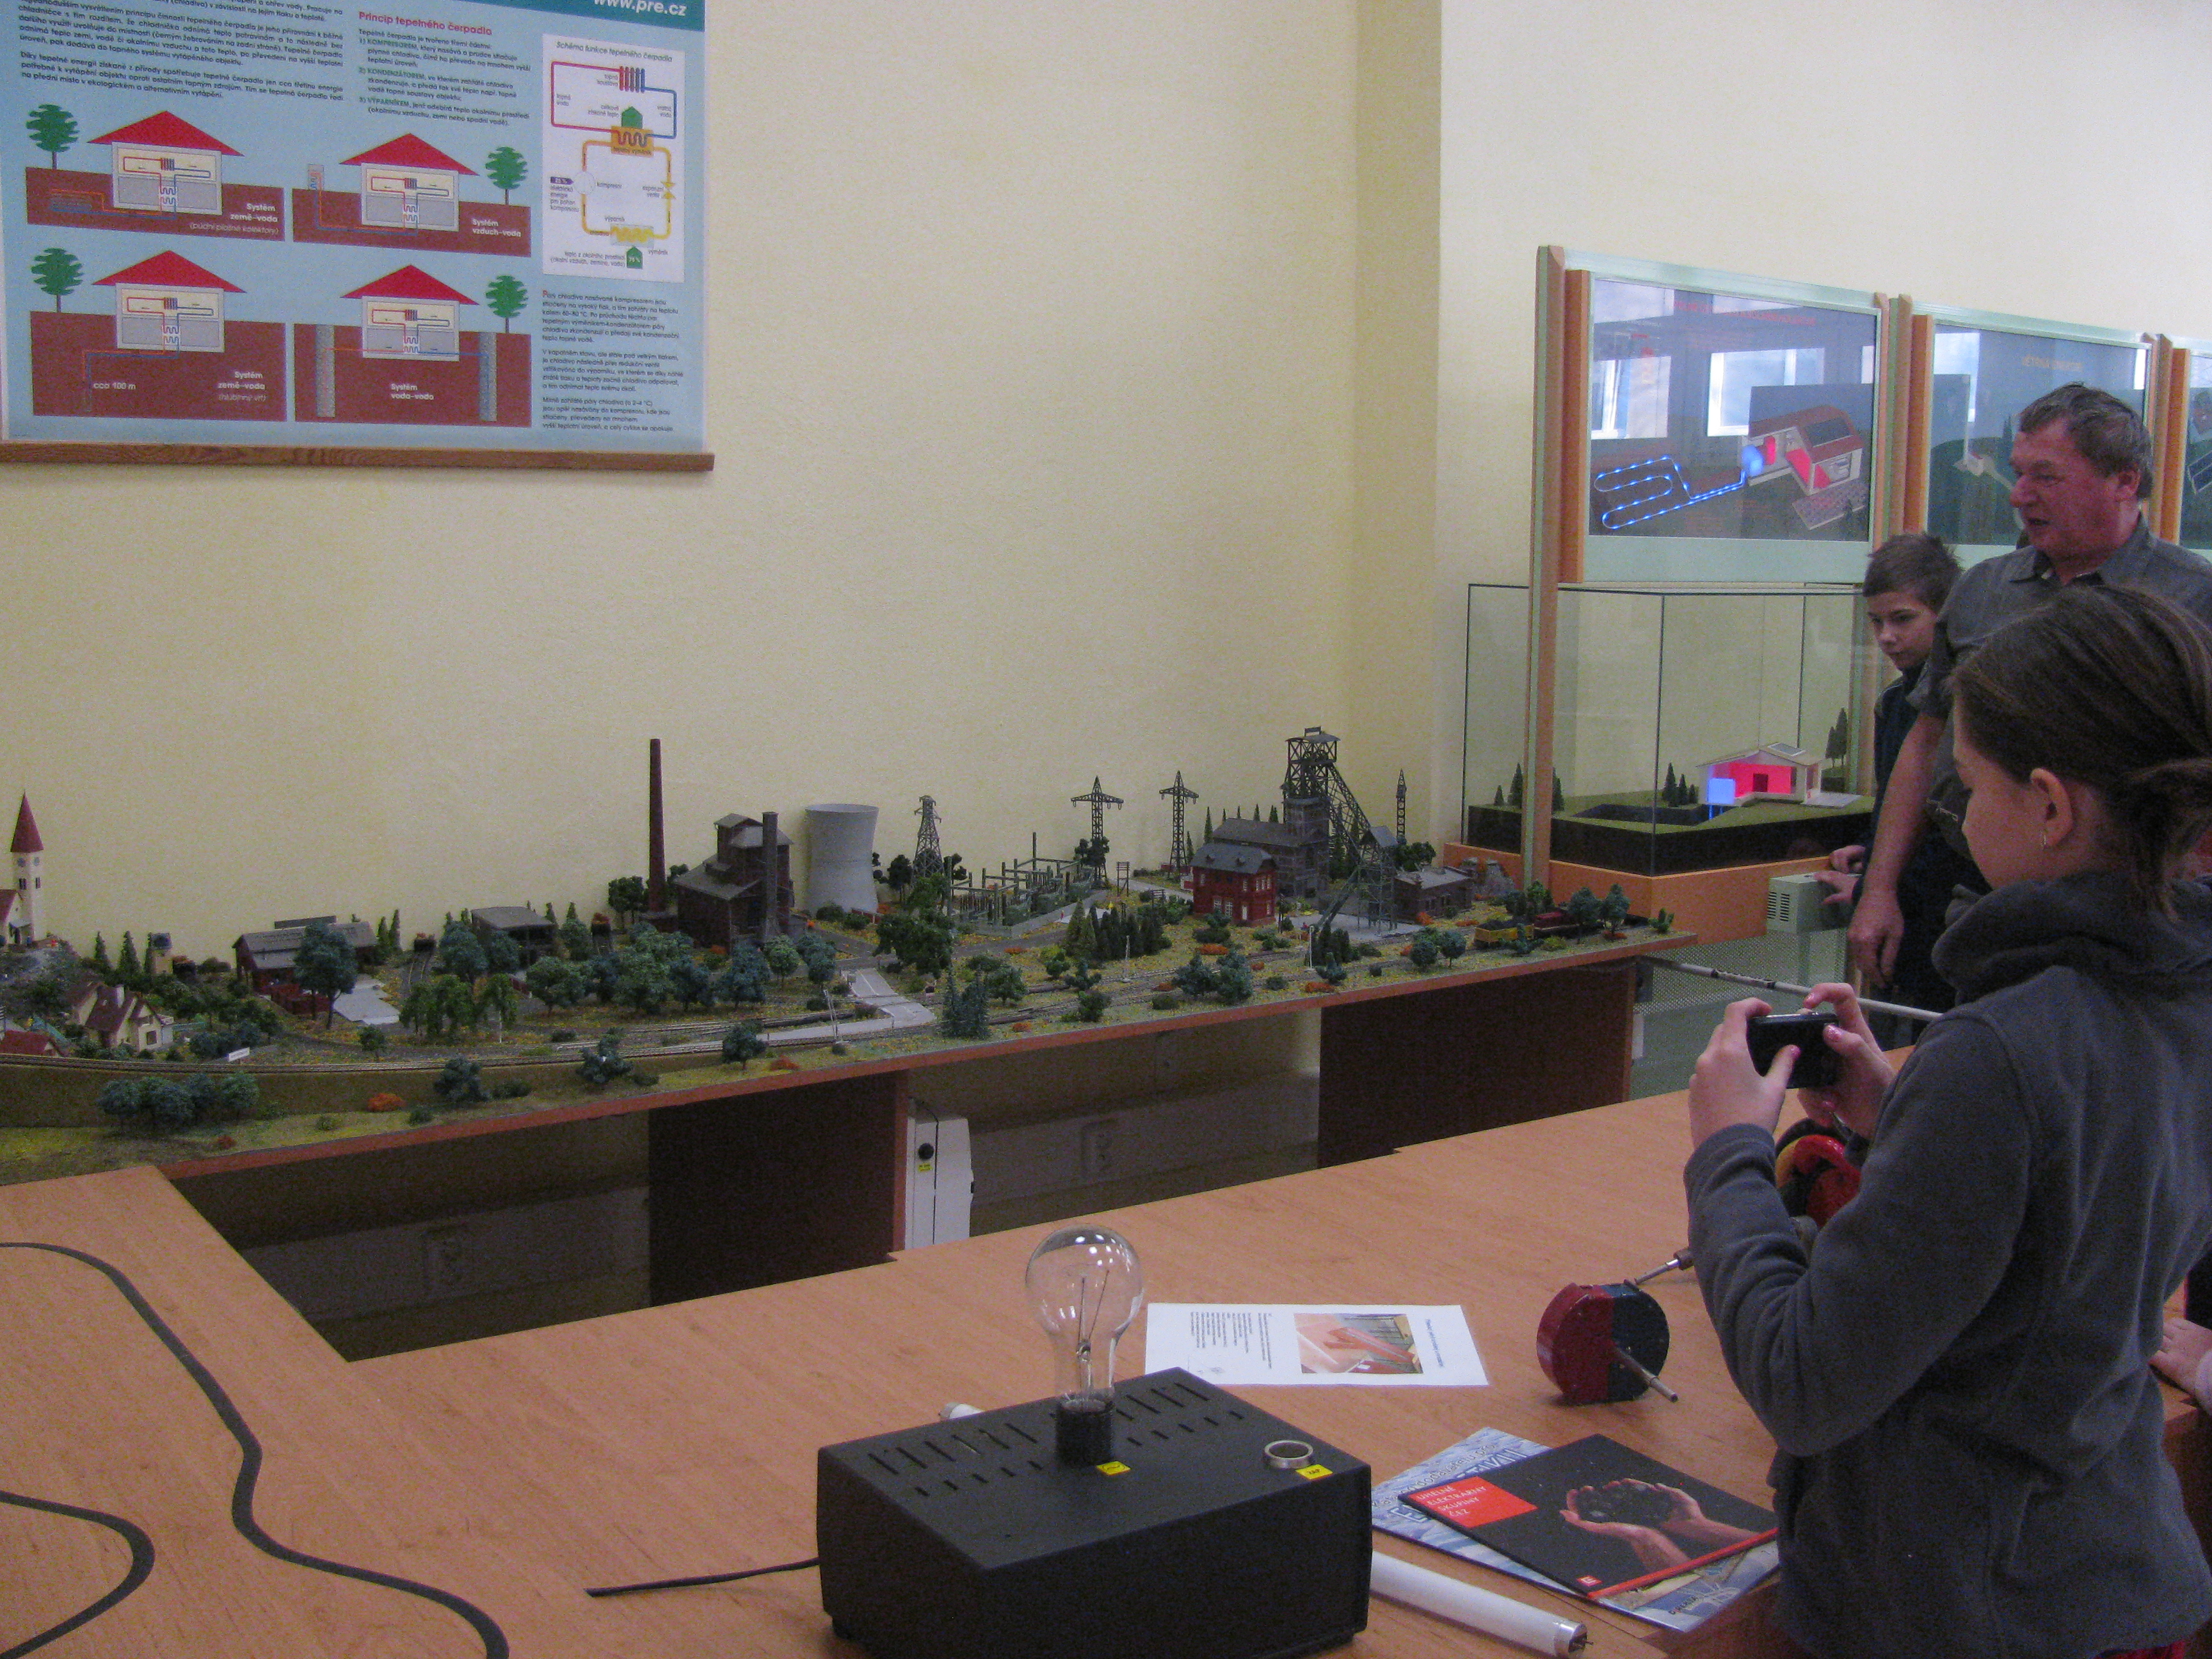
further education of pedagogical staff
professional training and seminars (Elektrotechnical gild Pilsen region, ABB s.r.o., Siemens s.r.o., etc.)
additional pedagogical study for teachers of vocational subjects
grant projects – KÚPK, Techmania Science Center, Nadace ČEZ, MŠMT, NAEP, atd.
public activities – interactive exhibition „World of Physics“, open days, professional training, accredited EDCL, etc.

Slide 10
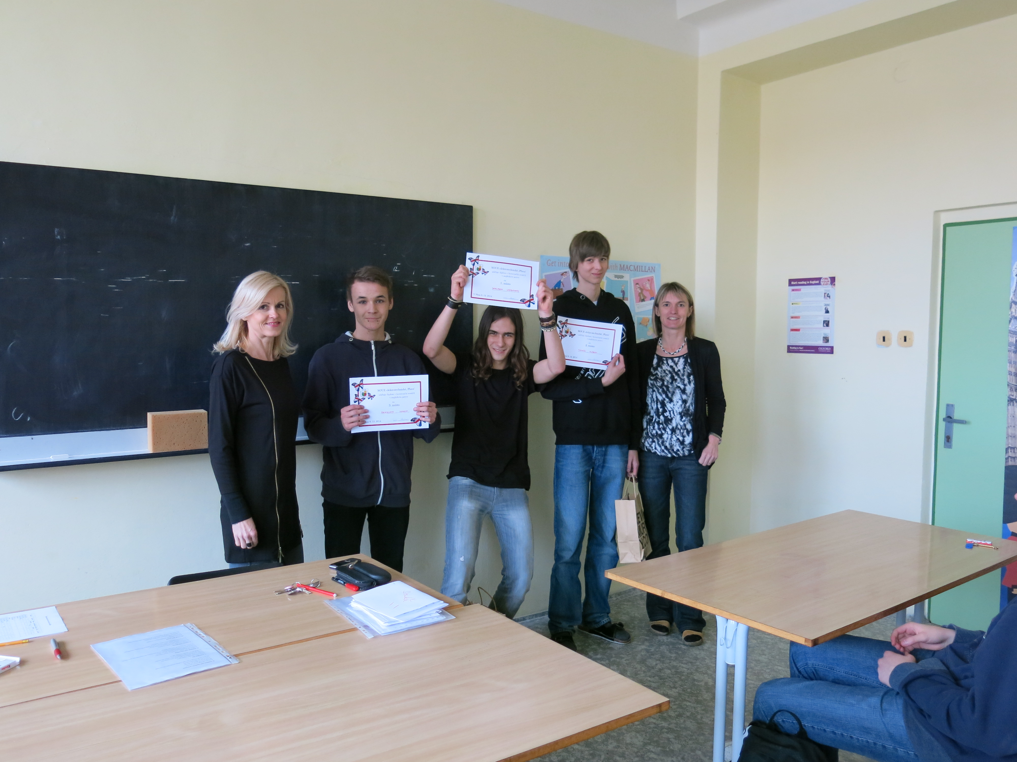
Successes of our students
Jablotron Cup – 1. place (individuals, 2011)
Green maus – 2. place (teams, 2012)
Nationwide competition profesional skills of ICT – 1. place (individuals, 2013)
Systherm – 1. place (teams, 2013)
GES Cup – 3. place (teams, 2014)
Nationwide mathematical competition for pupils of high school – 1. place (individuals, 2014)
Řemeslo má zlaté dno – 1. place (individuals, 2014)
Enersol – regular participation in the national round of the competition

Slide 11
Our teachers

Slide 12
Thanks for your attention !!!

