Slide 1
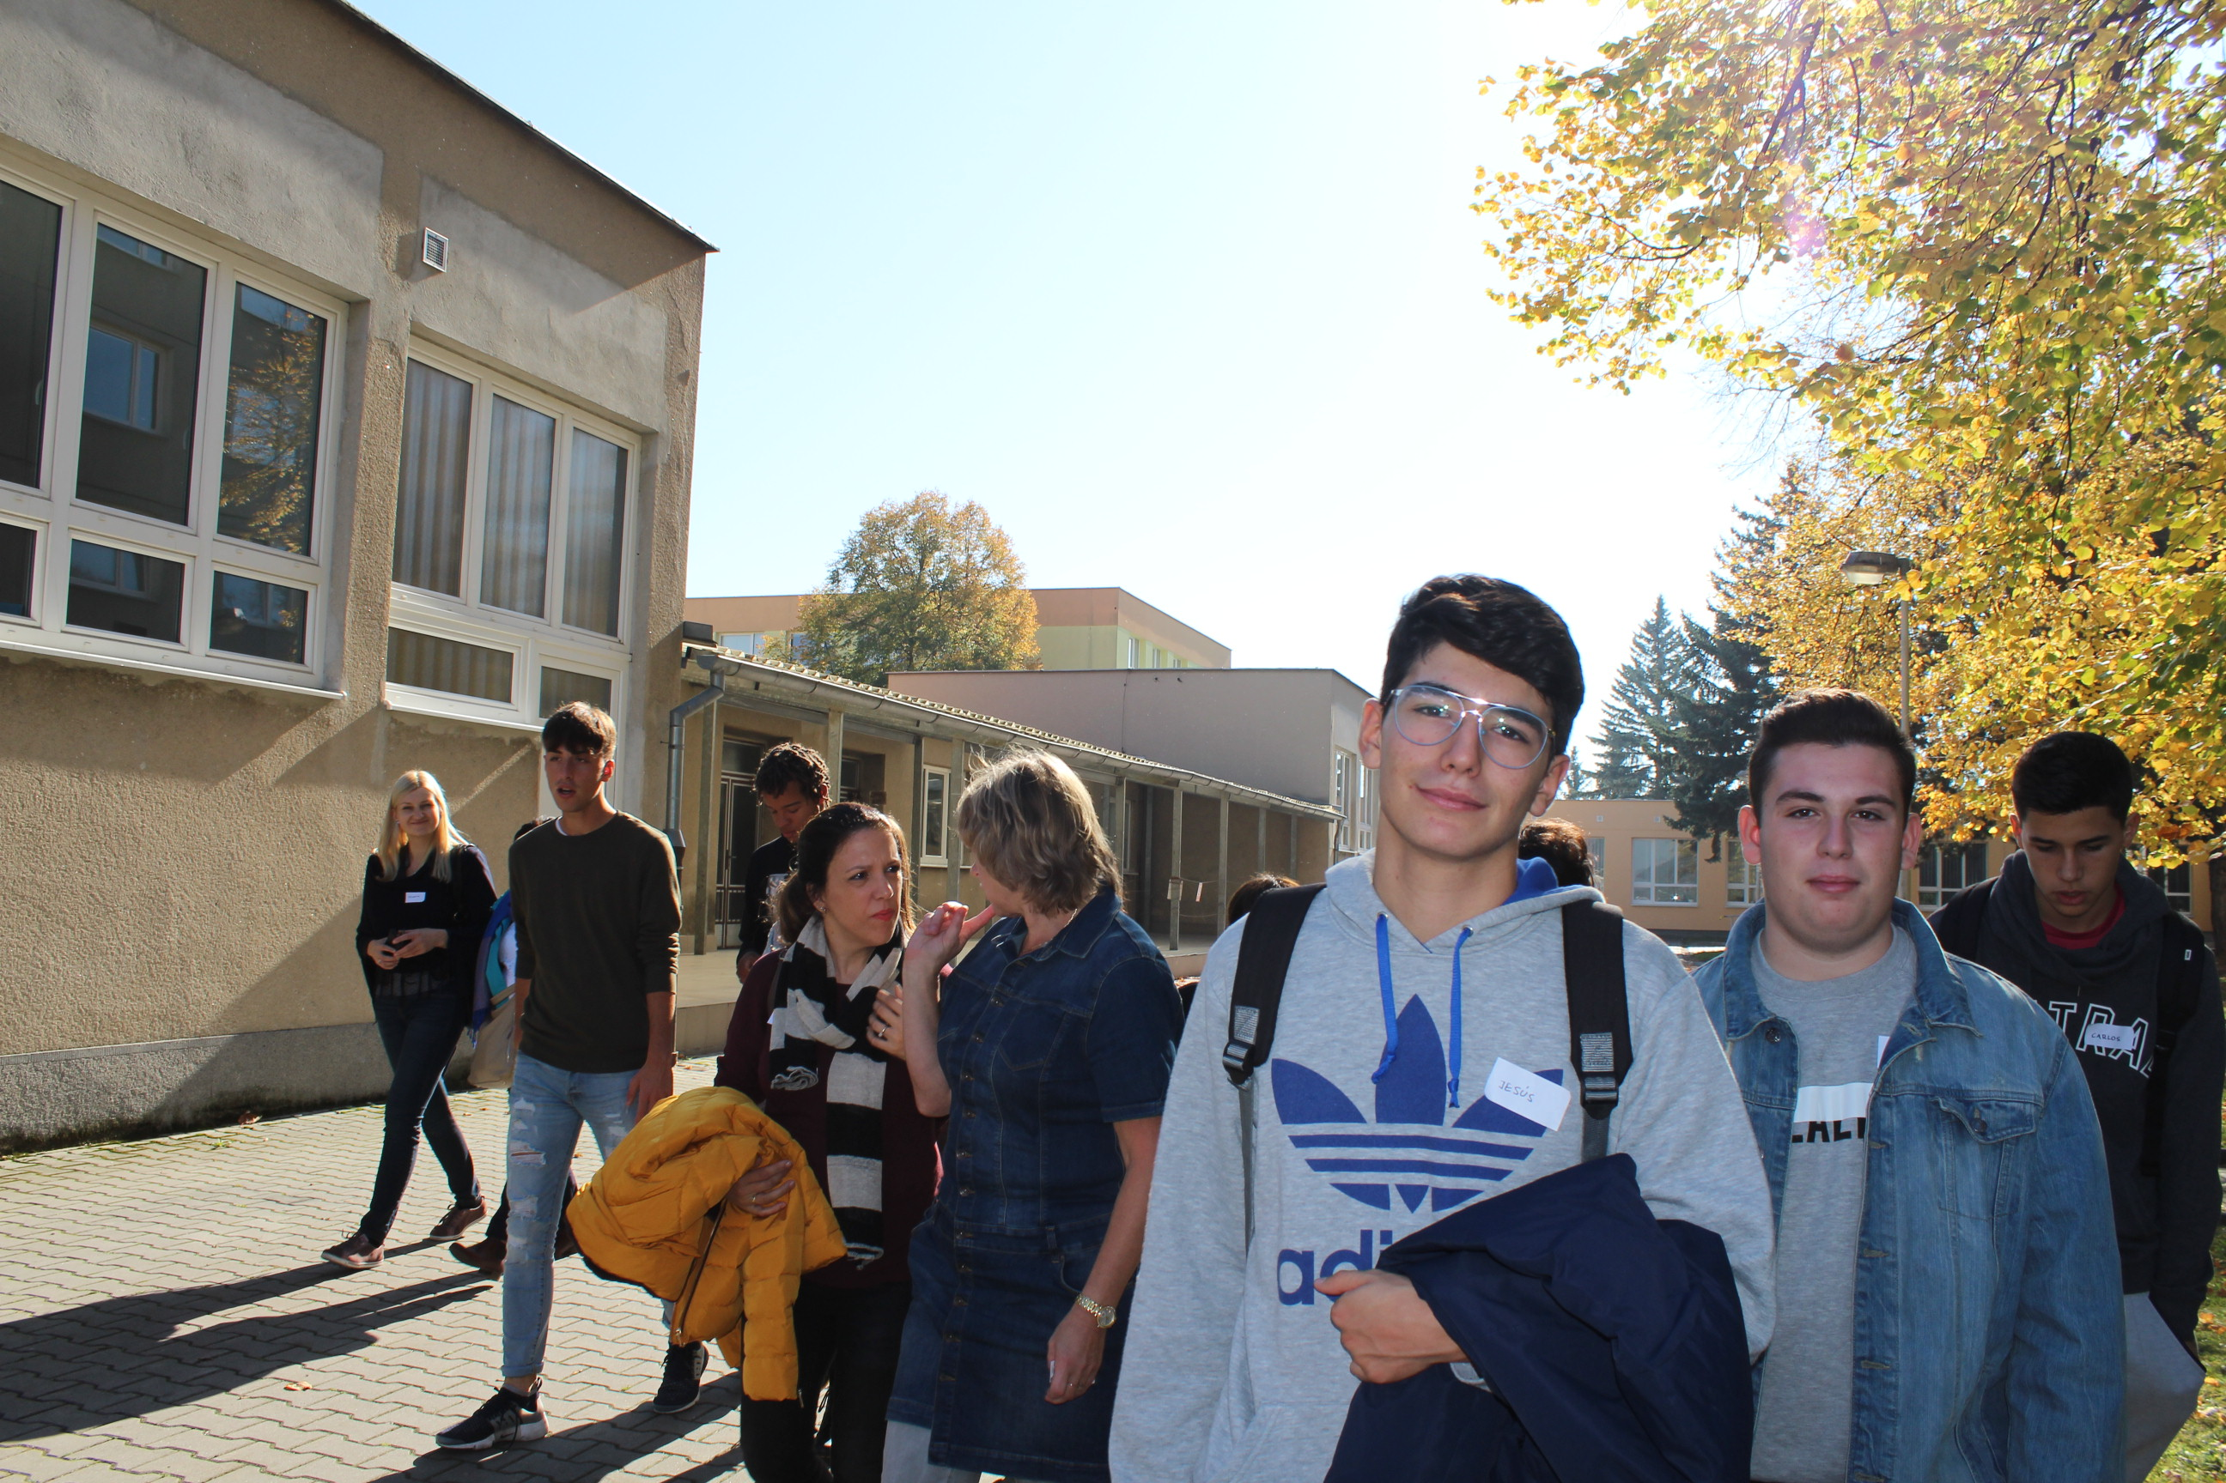
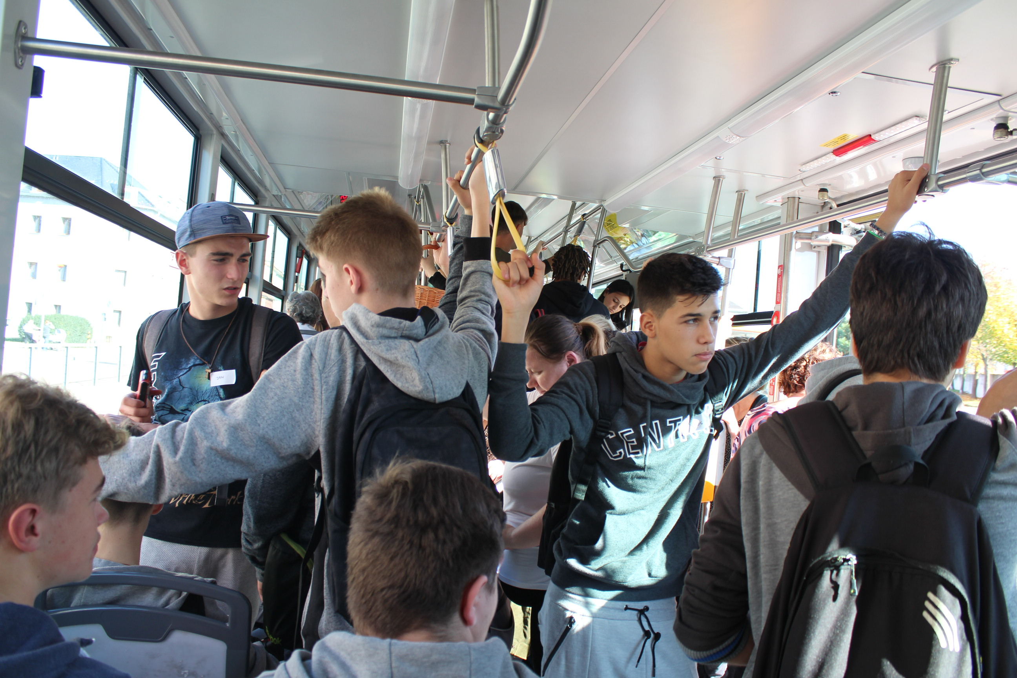
1st day October 15
All groups (Poland, Spain, Italy; Romania apologised and did not come) arrived and were
accommodated at the school hostel.

Slide 2
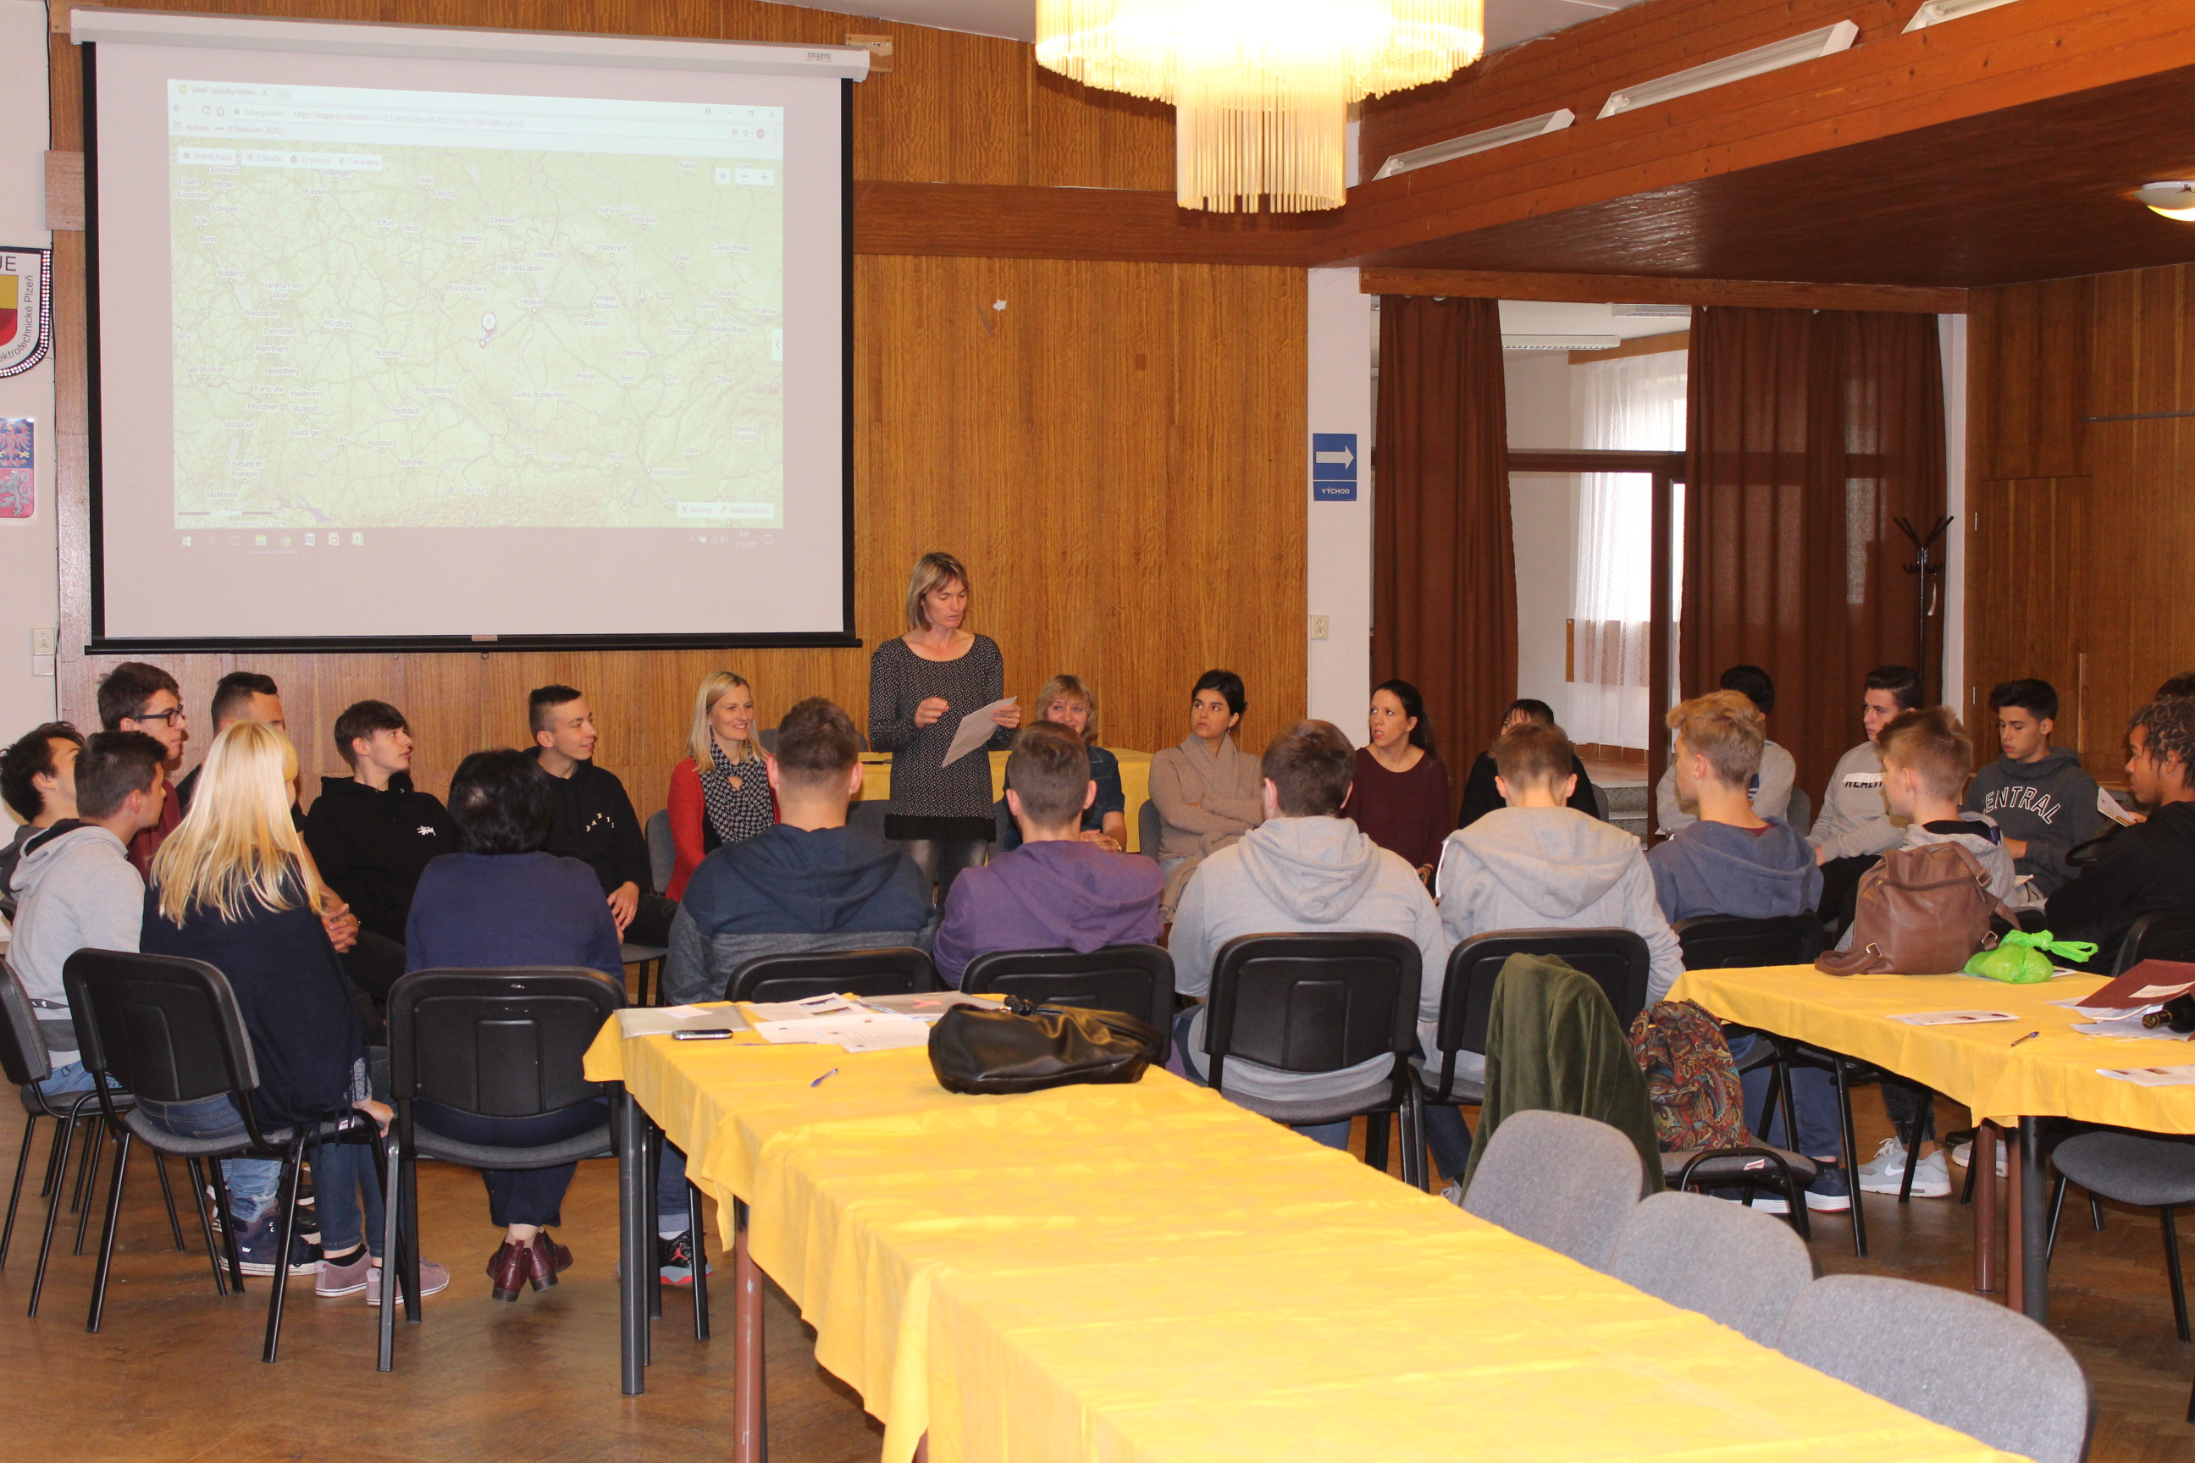
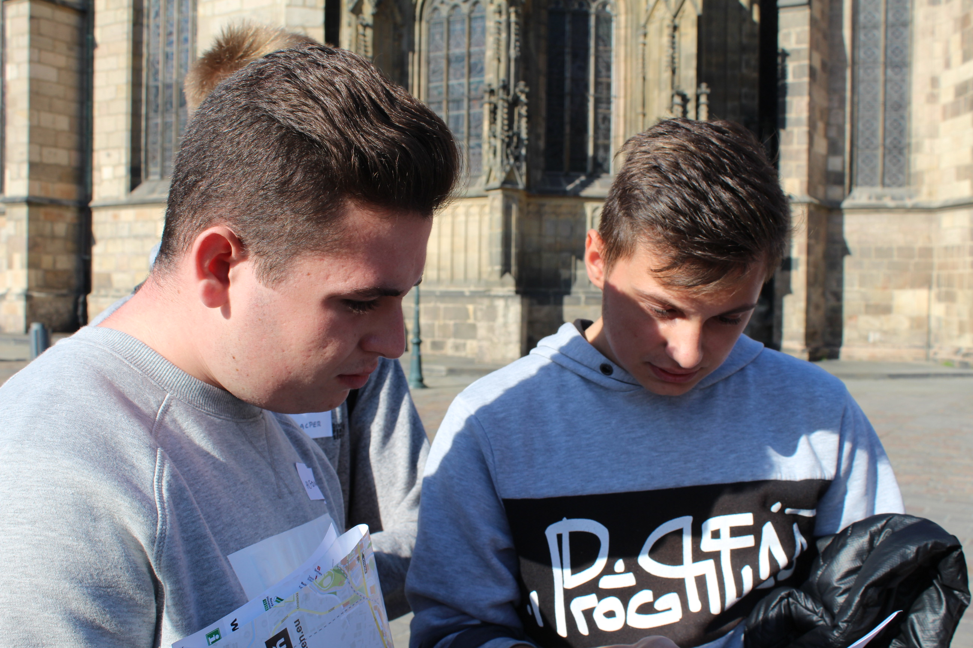
2nd day October 16
The groups were officially welcomed and greeted by the headmaster of the school Mr. Jaroslav Černý at SOUE.
After that we prepared ice-break activity for students and teachers to get to known each other better and to improve future communication among all participants. The Czech students prepared and presented several power point presentations in English – about Czech system of education, our school and Czech folk open-air museums (skanzens).
In the evening we prepared bowling match again in international teams – students and teachers as well participated in it.

Slide 4
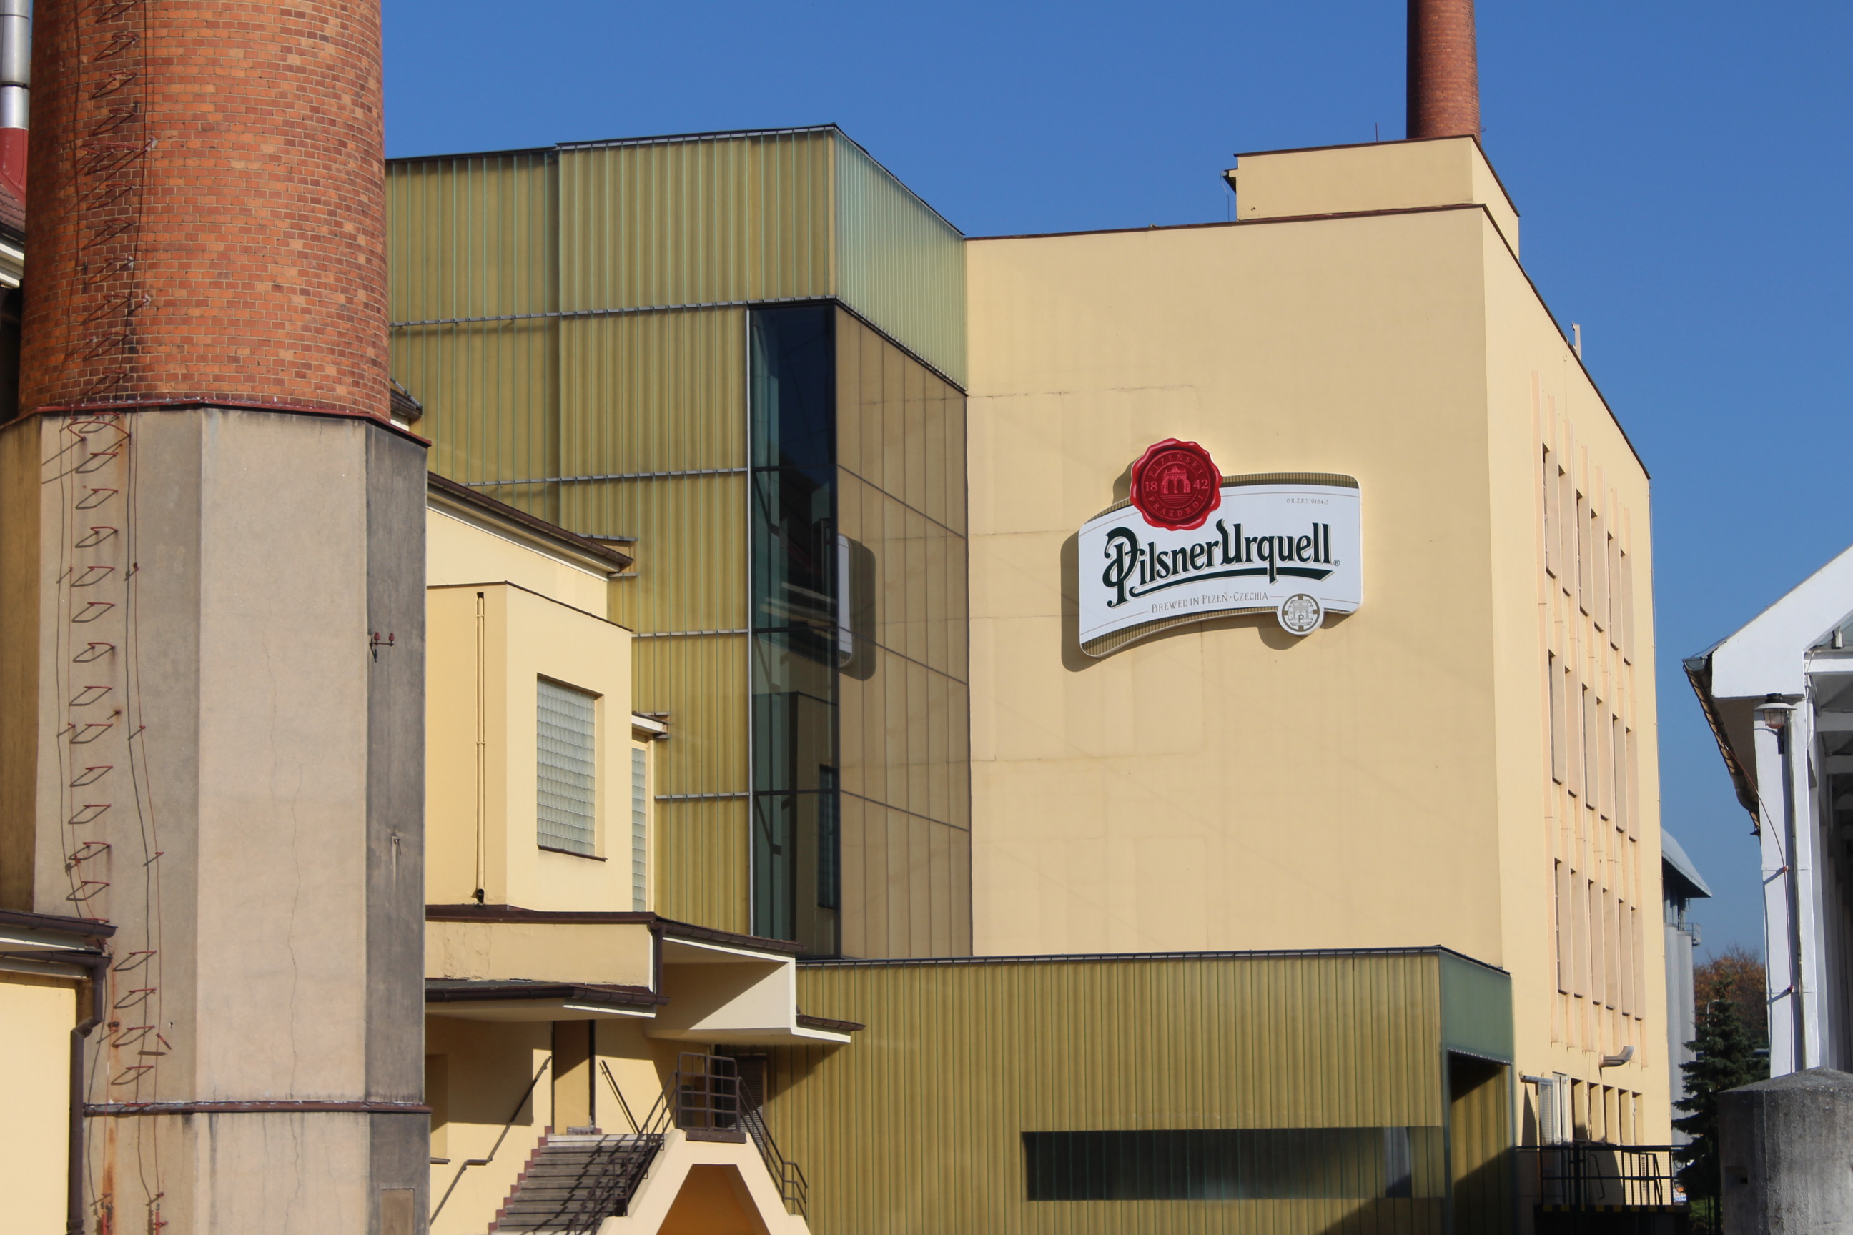
3rd day October 17
The day started with official welcome at Pilsen region council by the deputy of Pilsen region council president Ms Ivana Bartošová. During this meeting we introduced our project and pointed out that the project is financed by the European Union. We also saw the film and presentation in English about the region and the council. The meeting was filmed by the local TV “Plzeňská 1”. There was made a short spot with interviews with Czech, Polish and Italian students. So the public in Pilsen was informed about the project.
After that we made a guided excursion in English in Pilsner Urquell Brewery. Pilsner Urquell is the world’s first-ever pilsner type blond lager, making it the inspiration for much of the beer produced in the world today, many of which are named pils, pilsner and pilsener. We chose this company for several reasons – first the beer brewing certainly belongs to the Czech important traditions. But the second reason is that the brewery keeps also tradition – coopering – making wooden barrels by the original technique.
In the afternoon all groups visited by coach the permanent exhibition in the Centre for Building Heritage in Plasy which takes its visitors through the entire brewery grounds and acquaints them with historical construction components, materials and structures in a comprehensible and attractive manner.

Slide 5
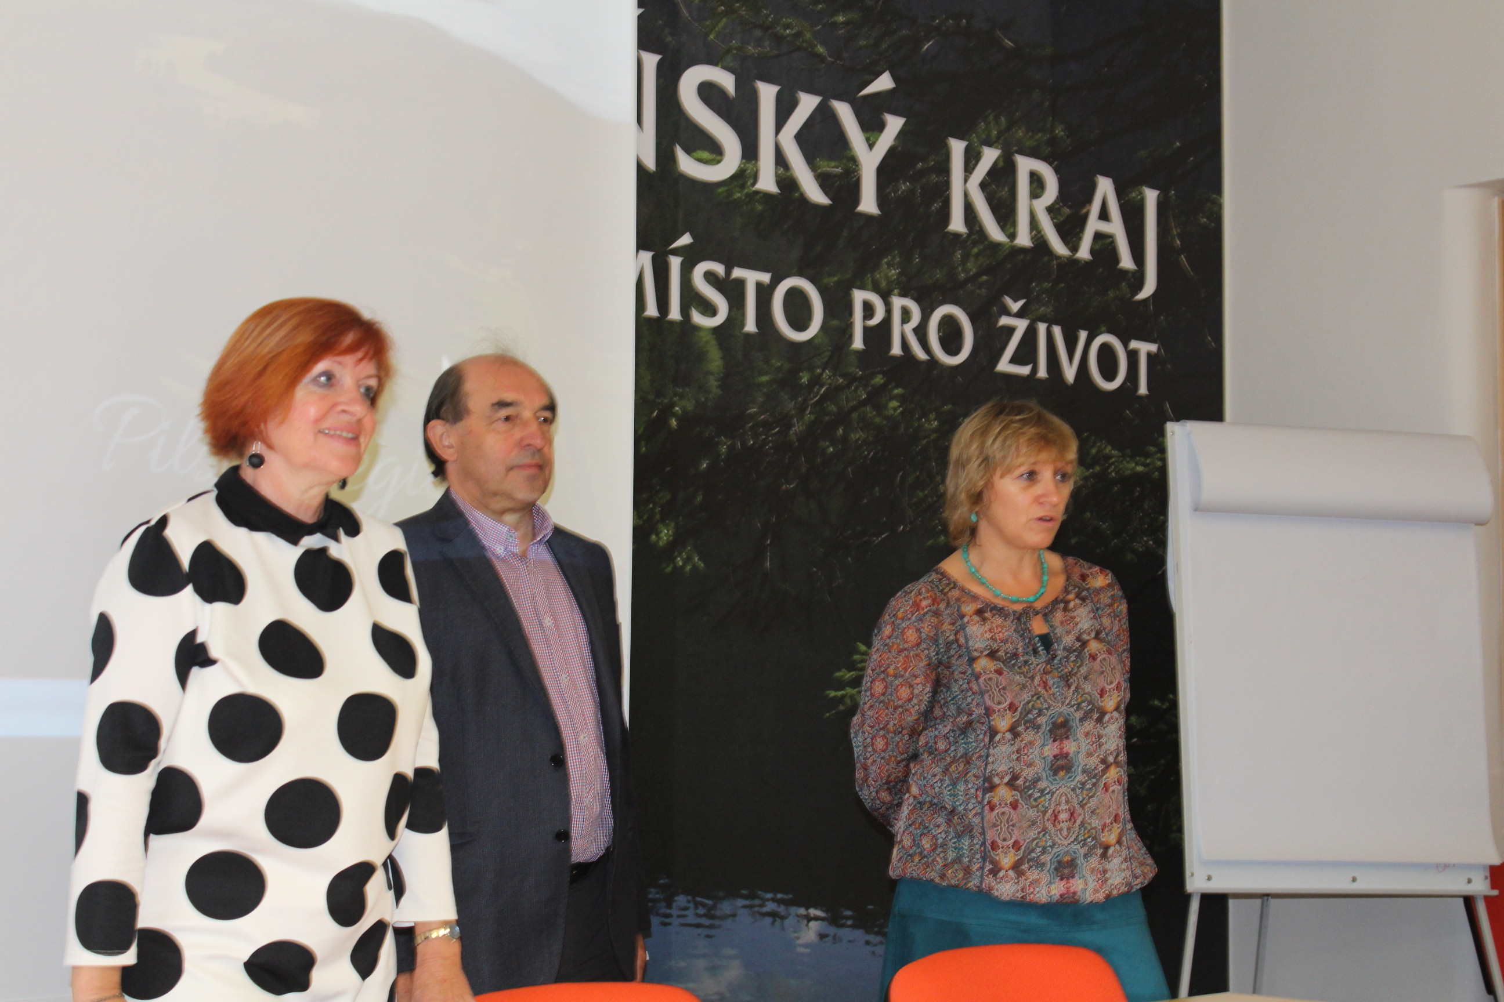
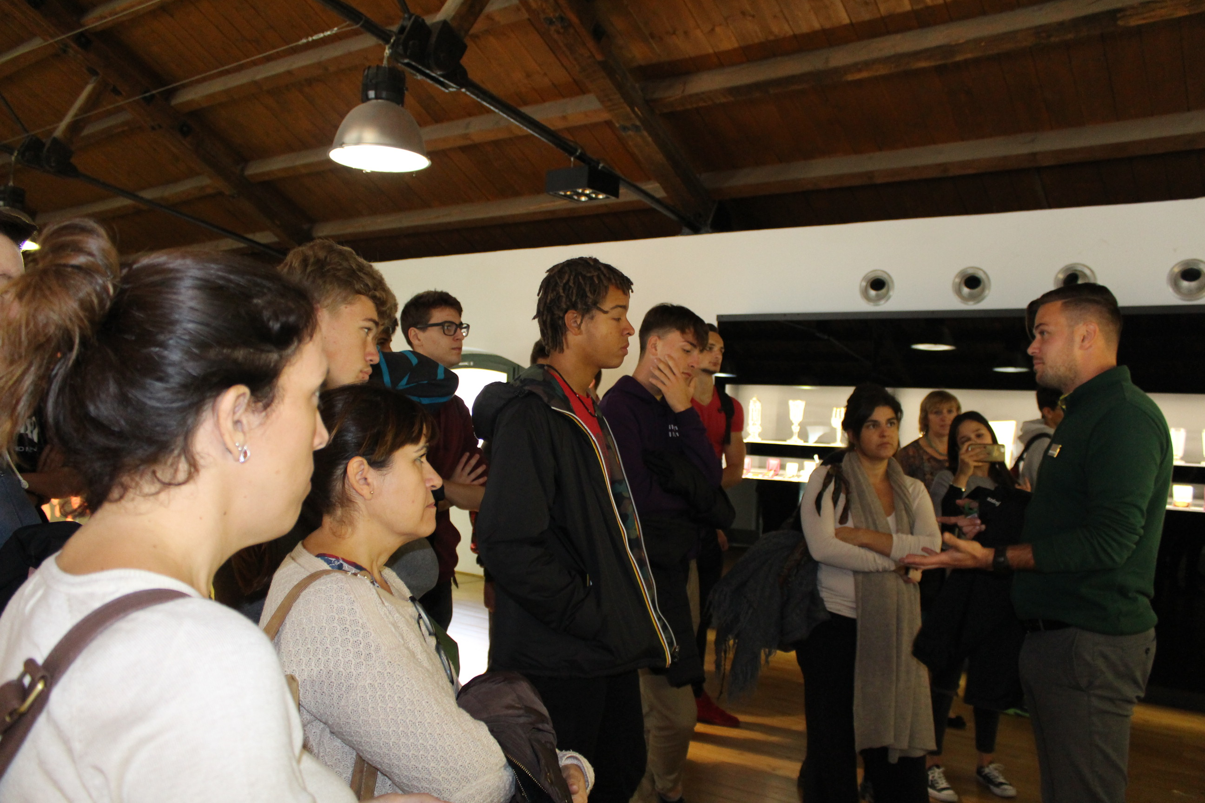
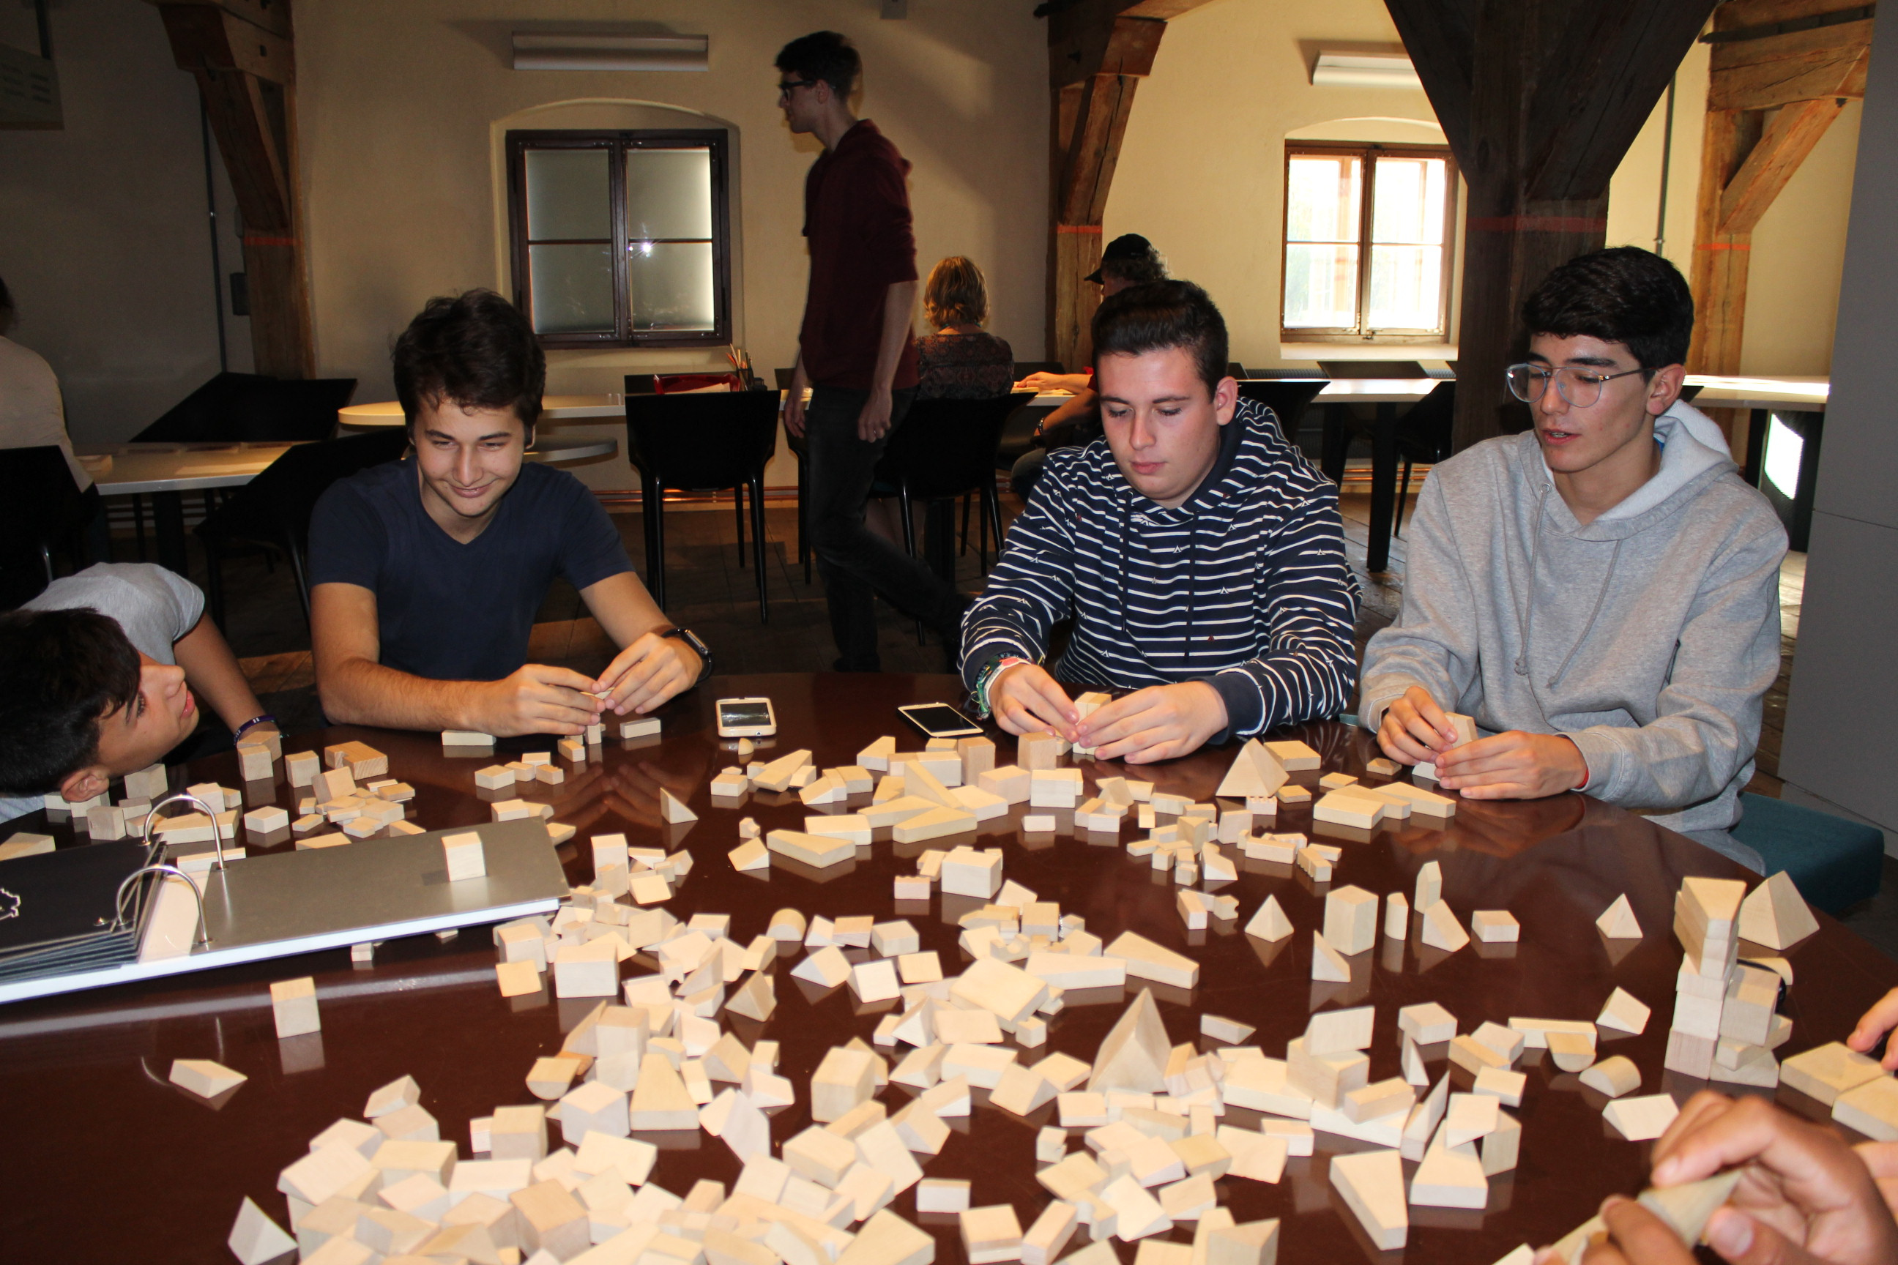
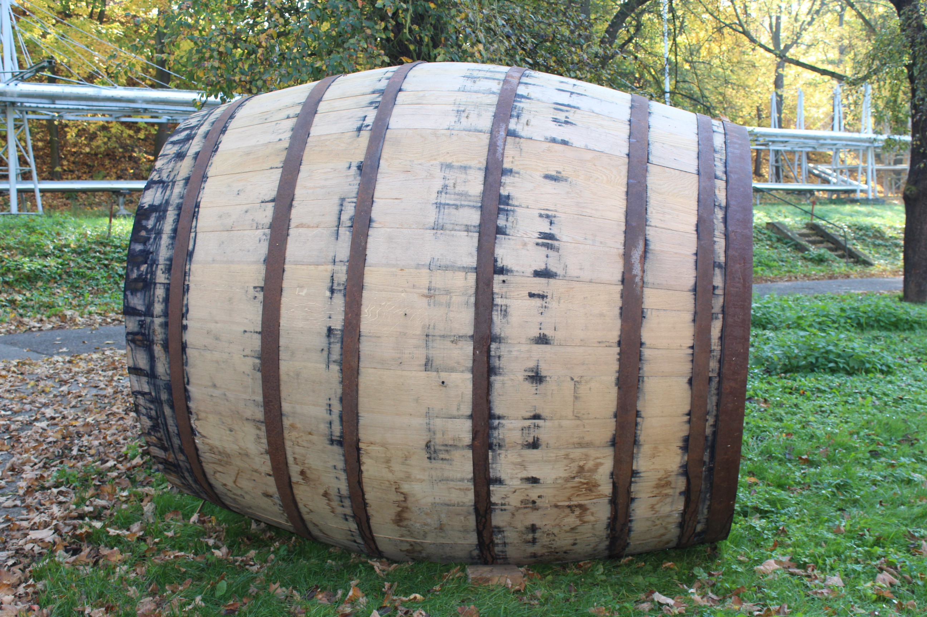

Slide 6
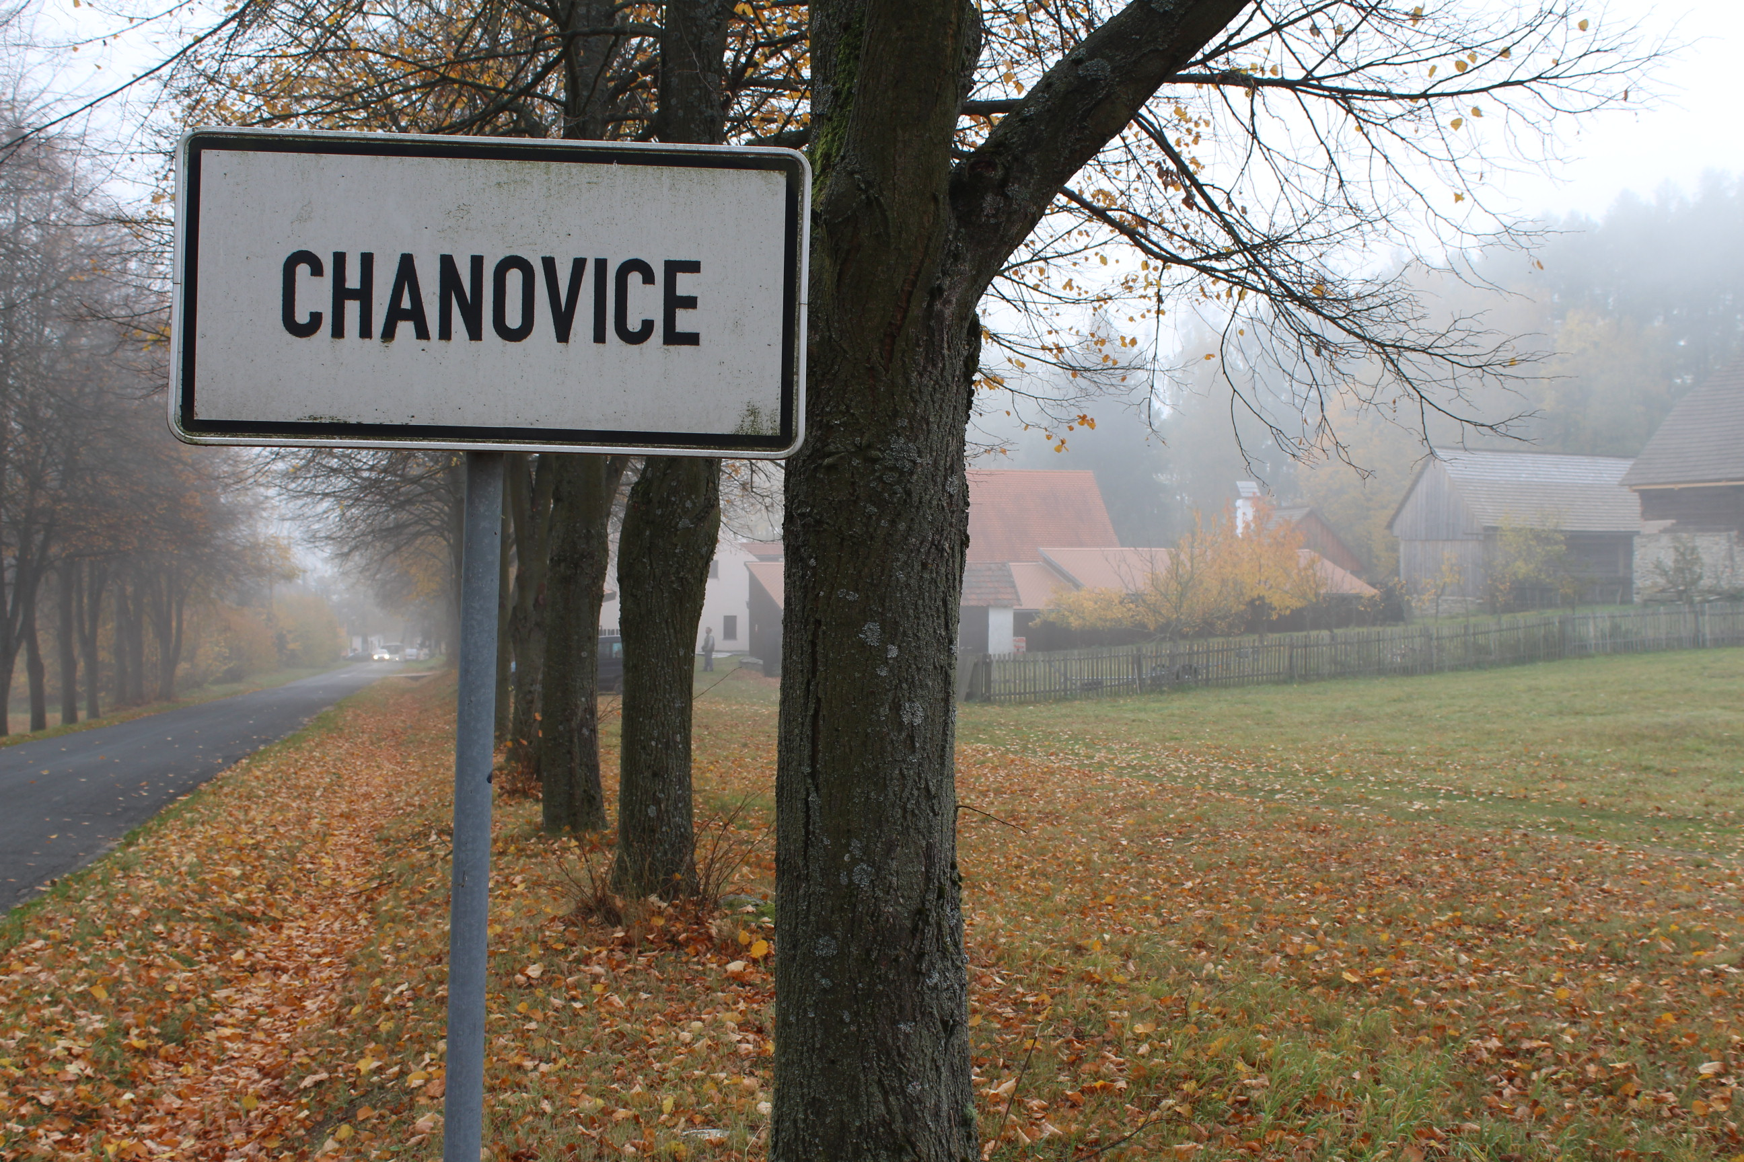
4th day October 18
The groups moved by coach to the near village in the south-west of Bohemia Chanovice (about 60 km from Pilsen). The village of Chanovice is the centre of cultural heritage of this region. There you can find a nice church, a castle where nowadays a primary school is located, a small museum of crafts, an exhibition hall and a gym. But also there is a big reconstructed granary which serves as a depository for the Museum of. Dr. Hostaše in Klatovy.
At the end of the day we went to the local lookout tower to see the beautiful countryside of this region and Šumava mountains. The Czech students and teachers stayed overnight at Chanovice skanzen, foreign groups were accommodated in the near town Horažďovice.

Slide 7
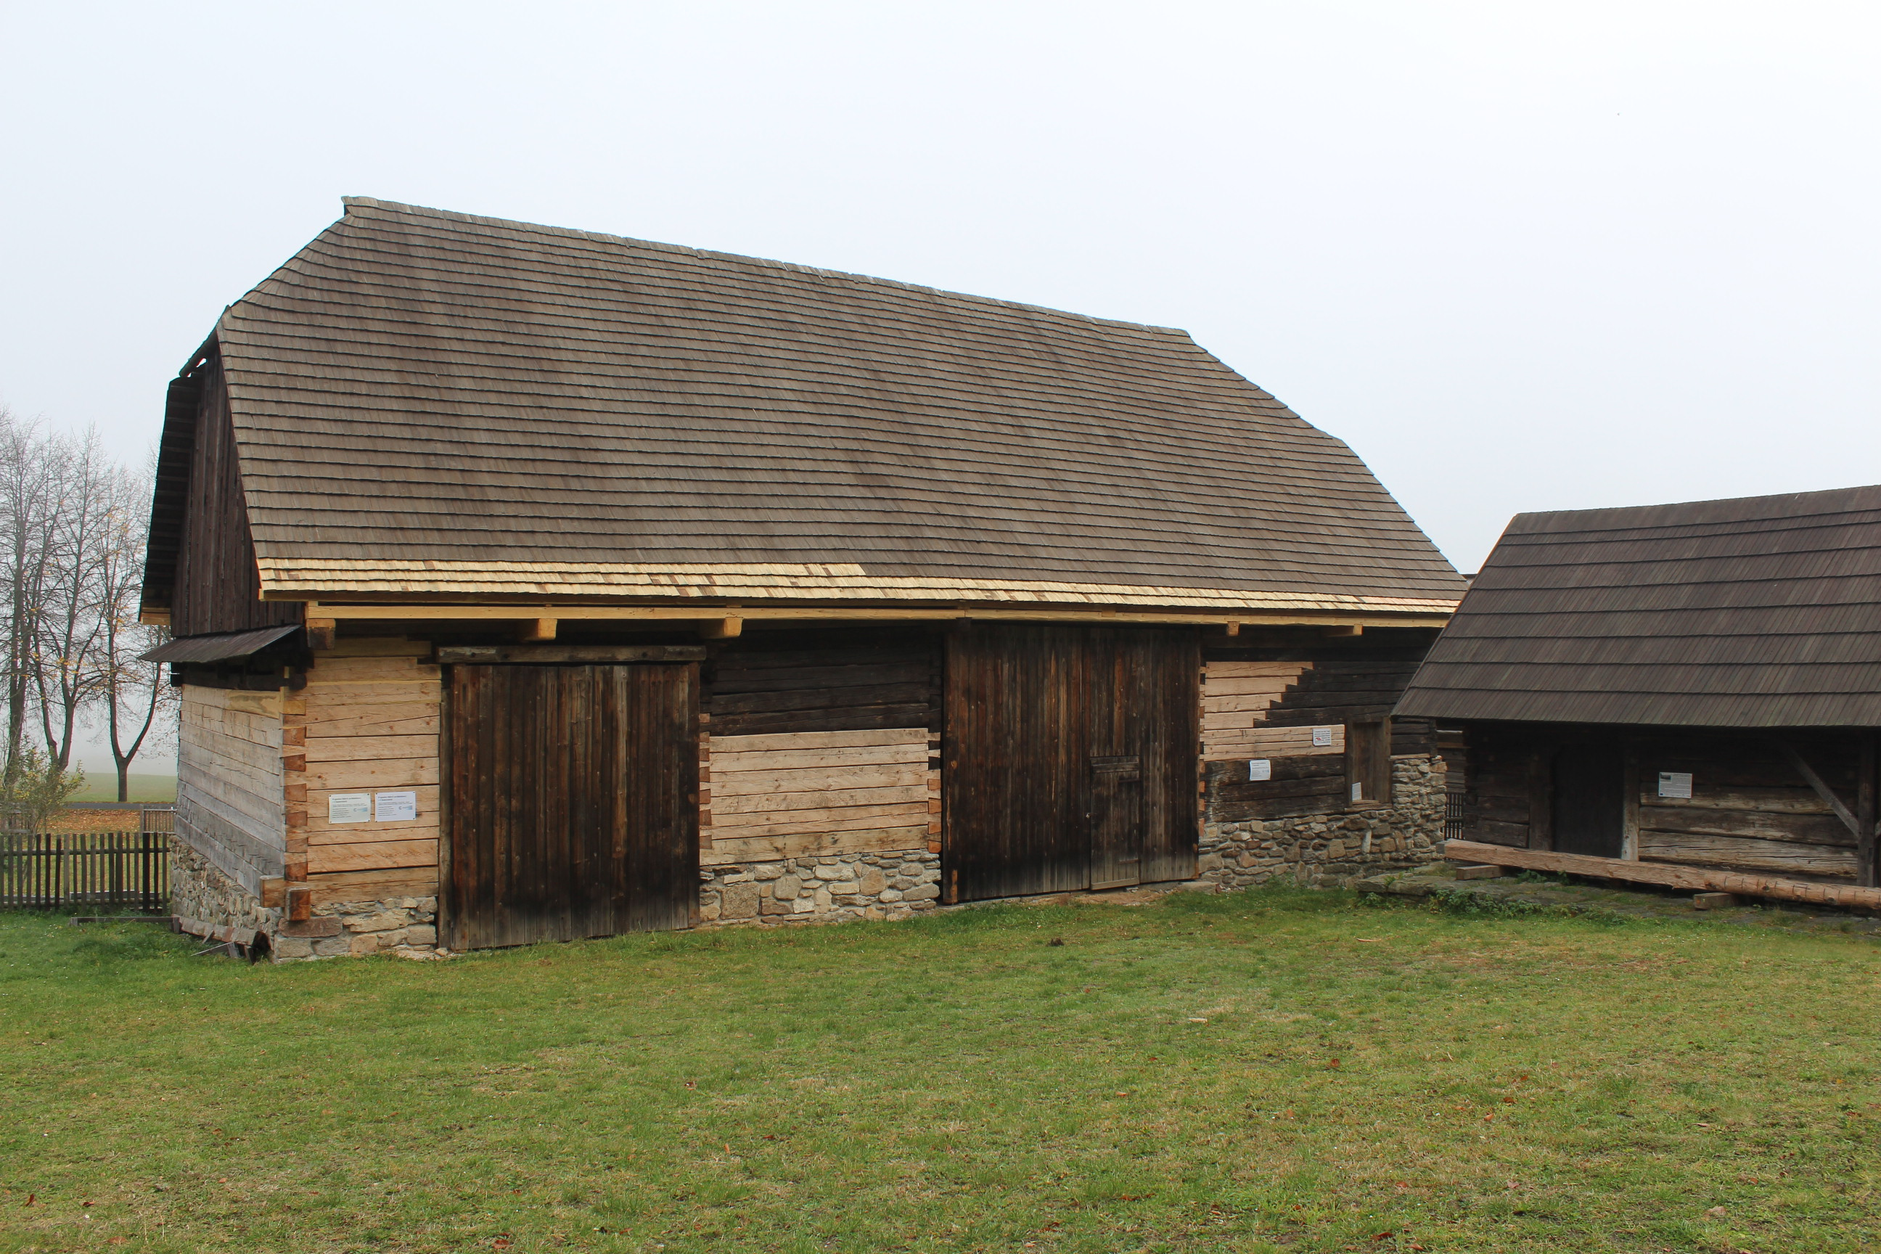
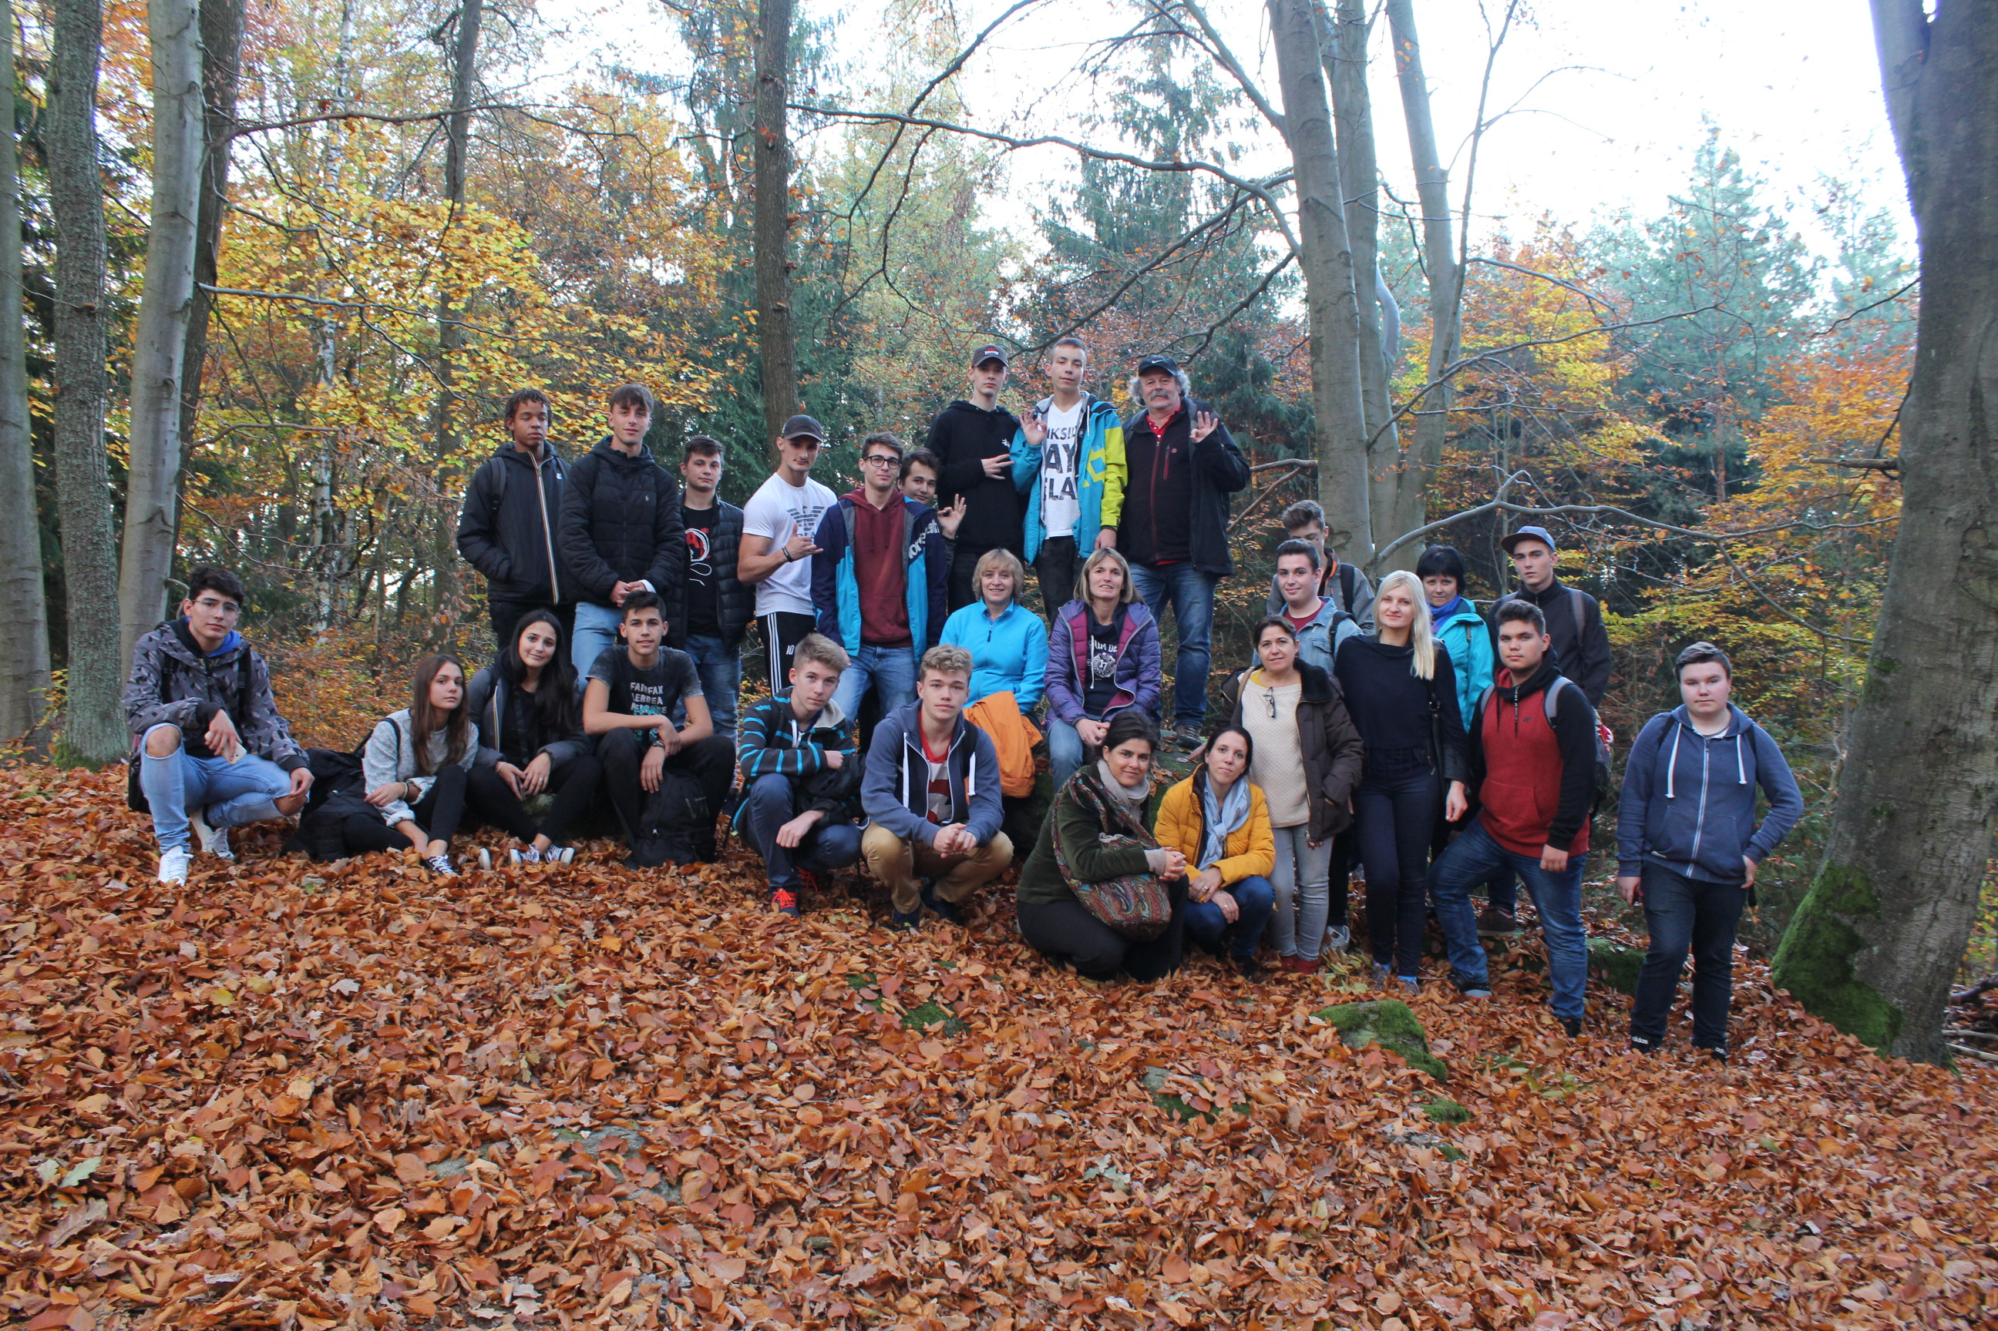
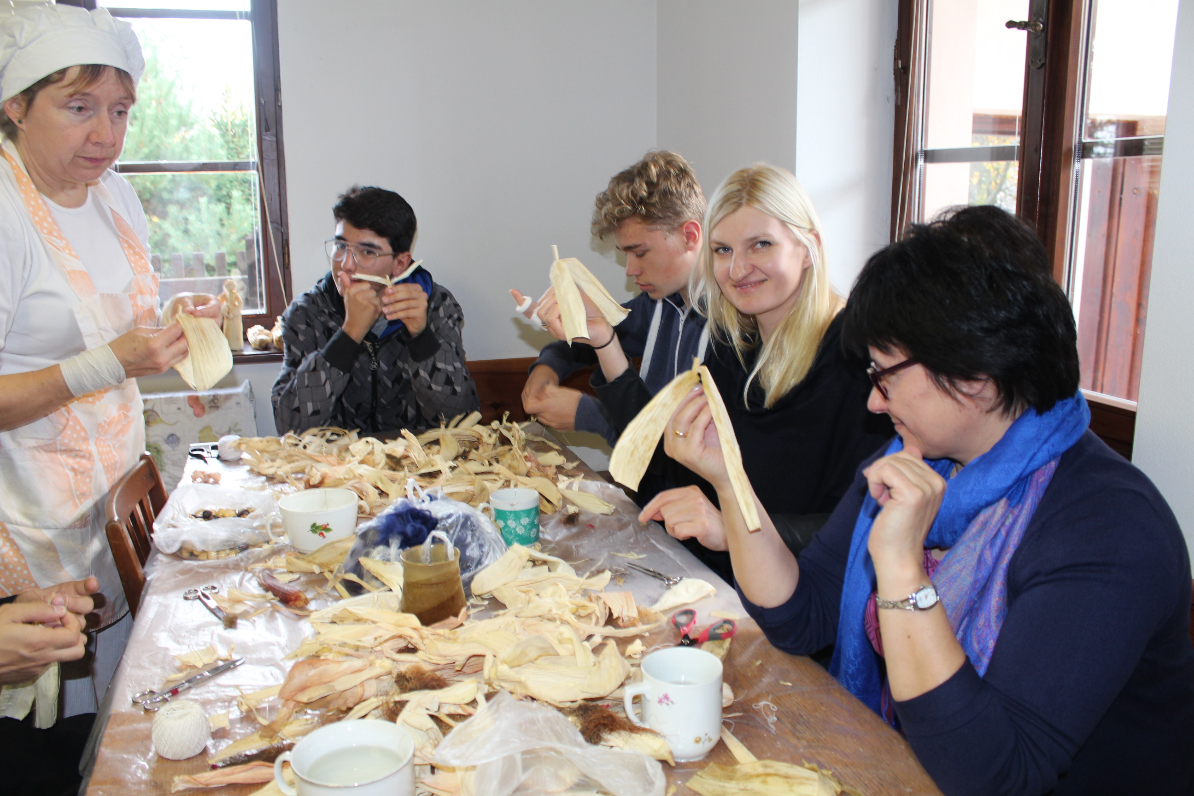

Slide 8
5nd day October 19
The first part of the day we spent again in Chanovice where the village mayor showed us the castle and primary school located in. He also explained us the history of the castle and the process of its reconstruction. There is also an exhibition of folk village crafts from the 19 and the first half of 20th century – tools, products, and small machines.
Then we moved by coach to the Open Air Folk Museum in Prerov nad Labem. The Polabian Ethnographic Museum in Přerov nad Labem is located in the middle of the village near the capital city Prague in the central part of the CR. It illustrates the life in the Polabian village from the middle of the 18th century until the first half of the 20th century. The exhibition object, adapted to the &quot;old Bohemian cottage&quot;, was first made available to the public in 1900.

Slide 9
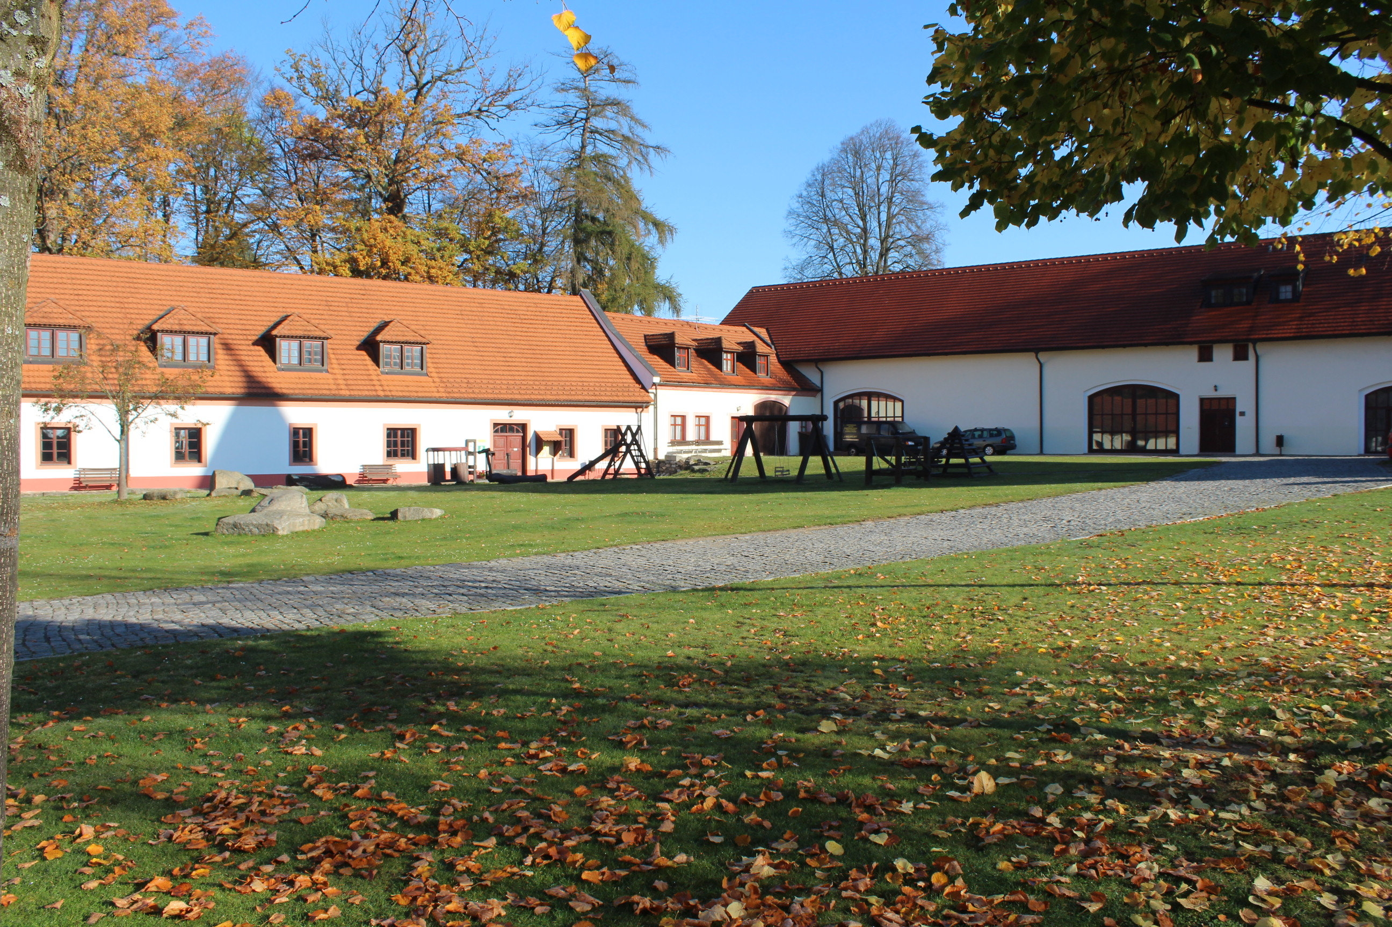
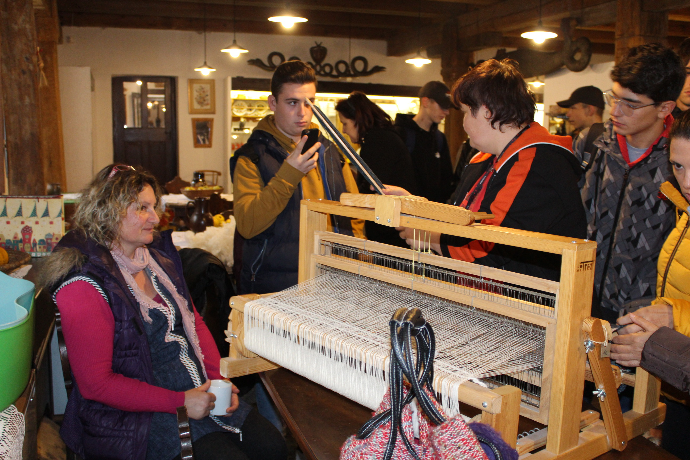
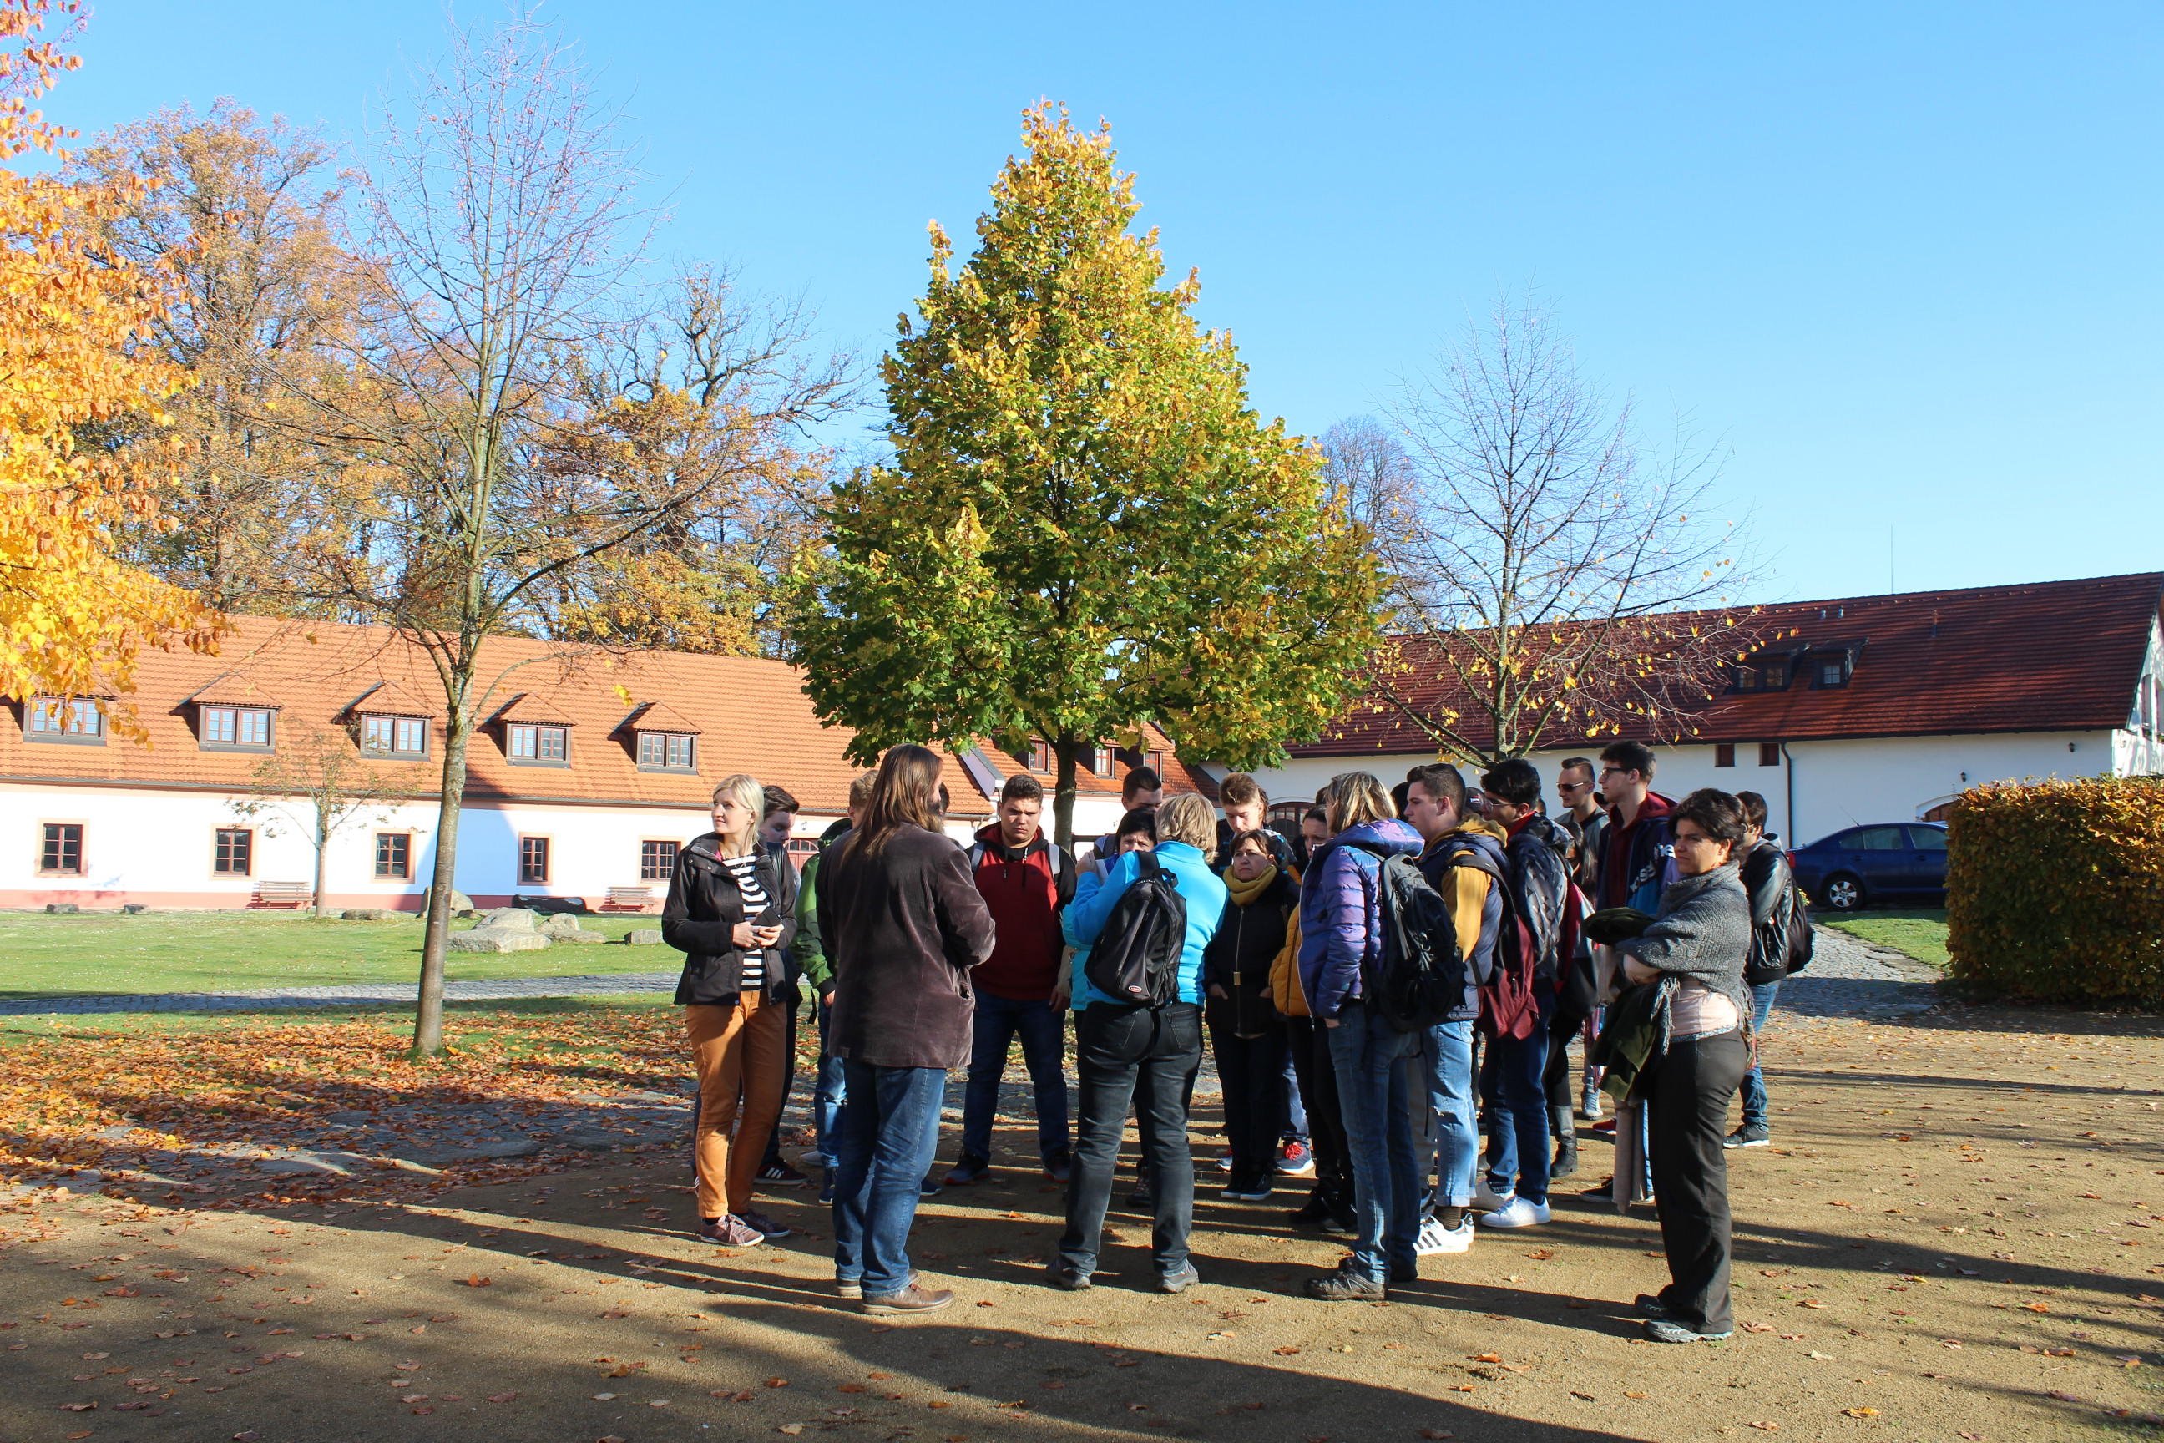
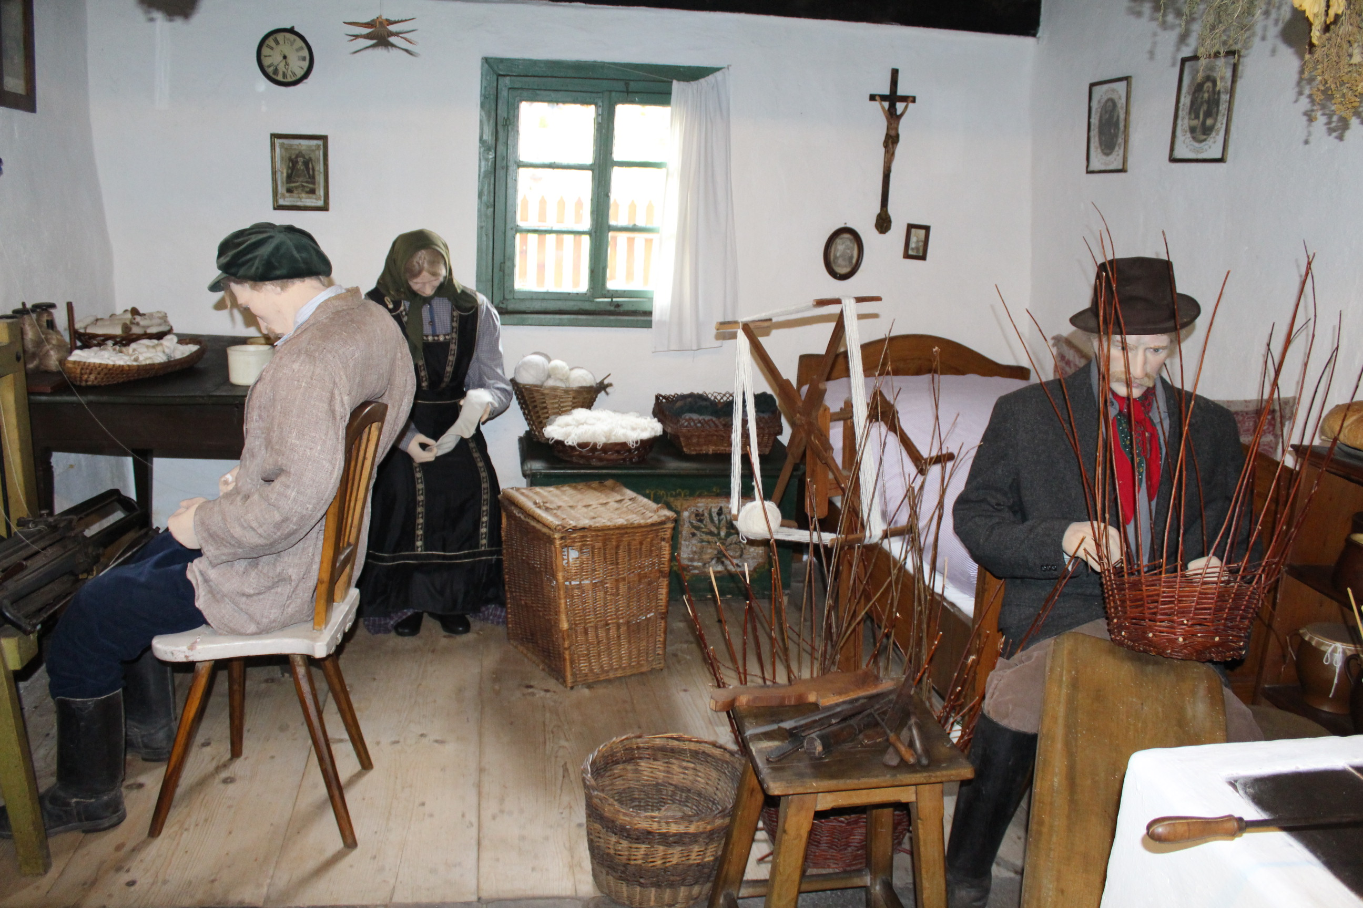

Slide 10
6th day October 20
The last day of this activity we spent in Prague. Prague is the capital and largest city of the Czech Republic. It is the 14th largest city in the European Union. It is also the historical capital of Bohemia. Situated in the north-west of the country on the Vltava River, the city is home to about 1.4 million people.
During the sightseeing we were guided by the professional guide who showed us the historical part of the city and Prague castle, talked about the history of the city and the CR and showed us all important sights.

Slide 11
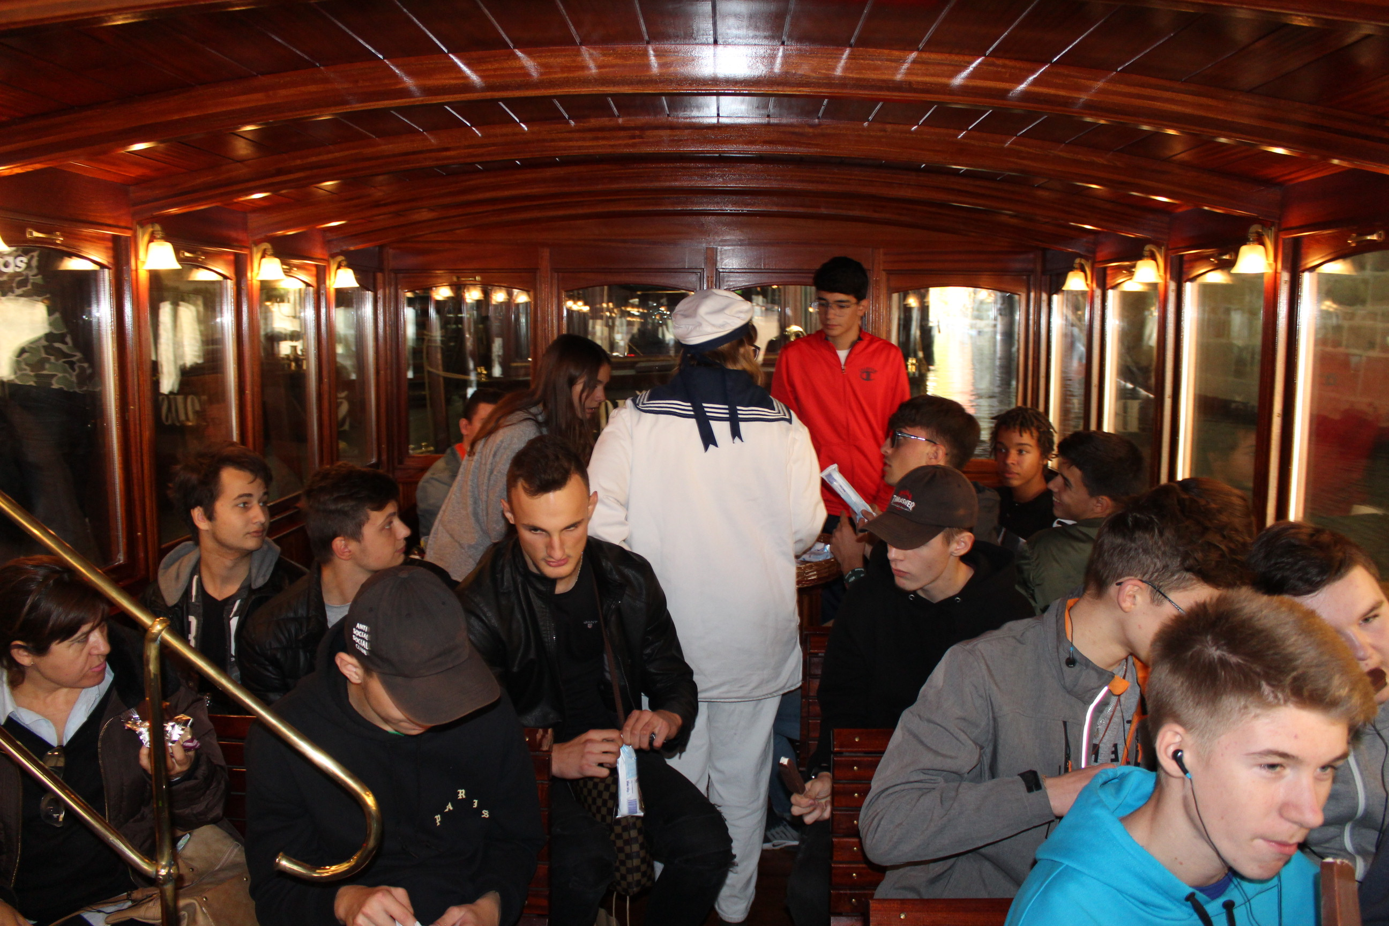
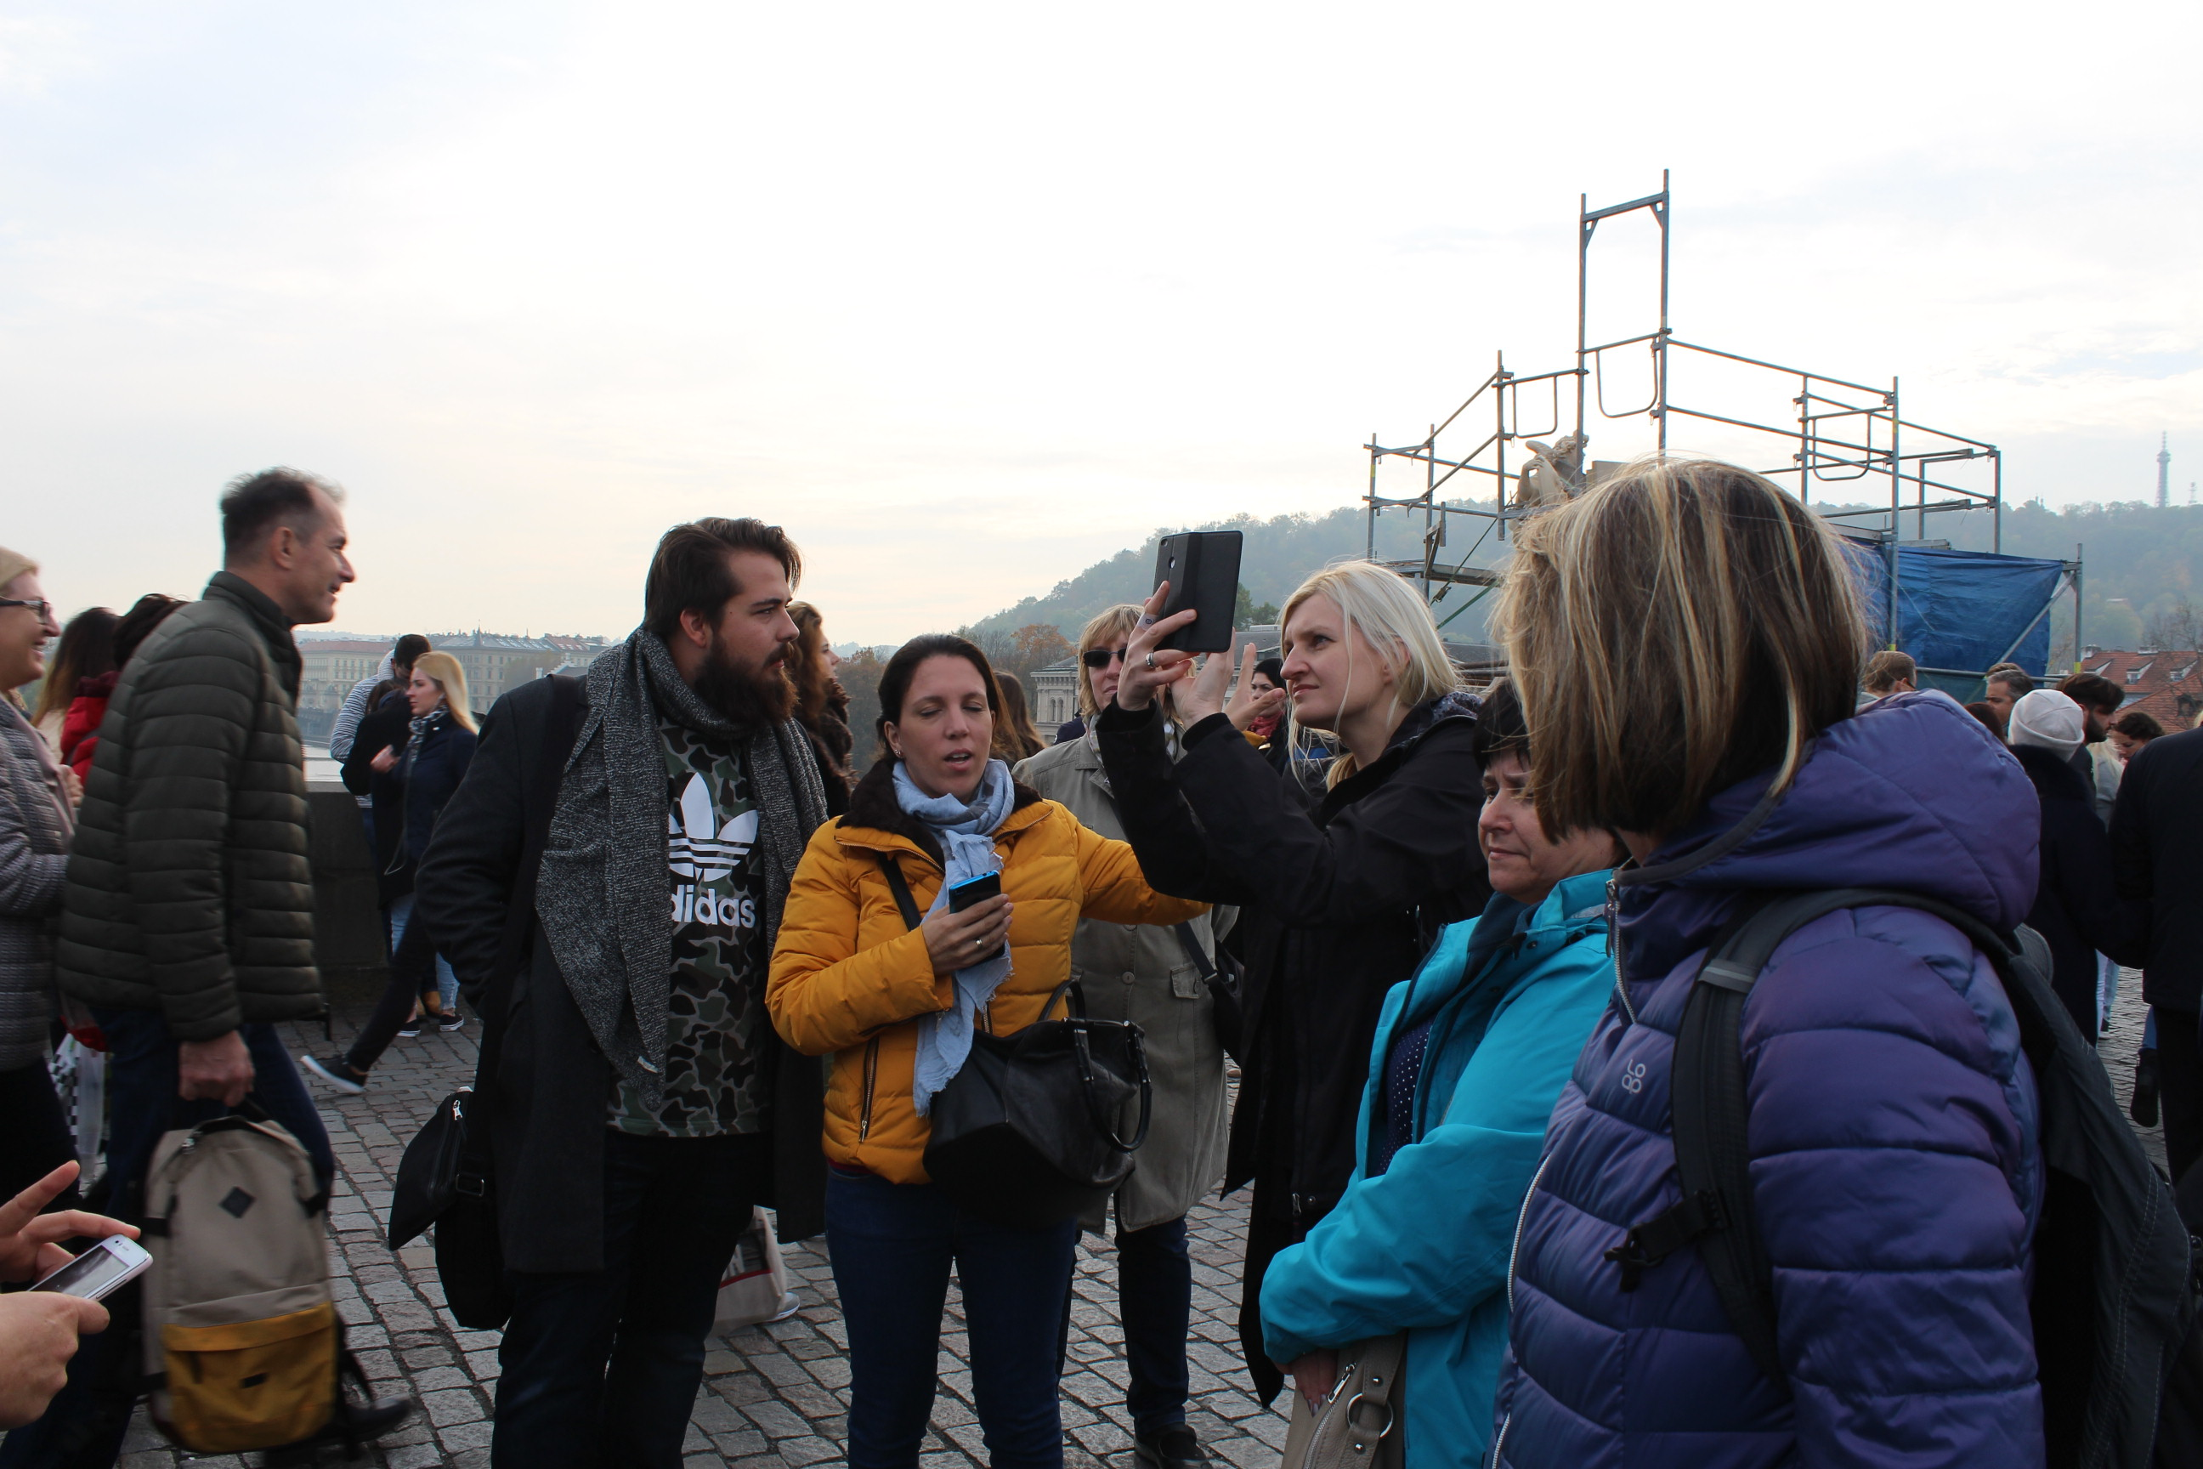
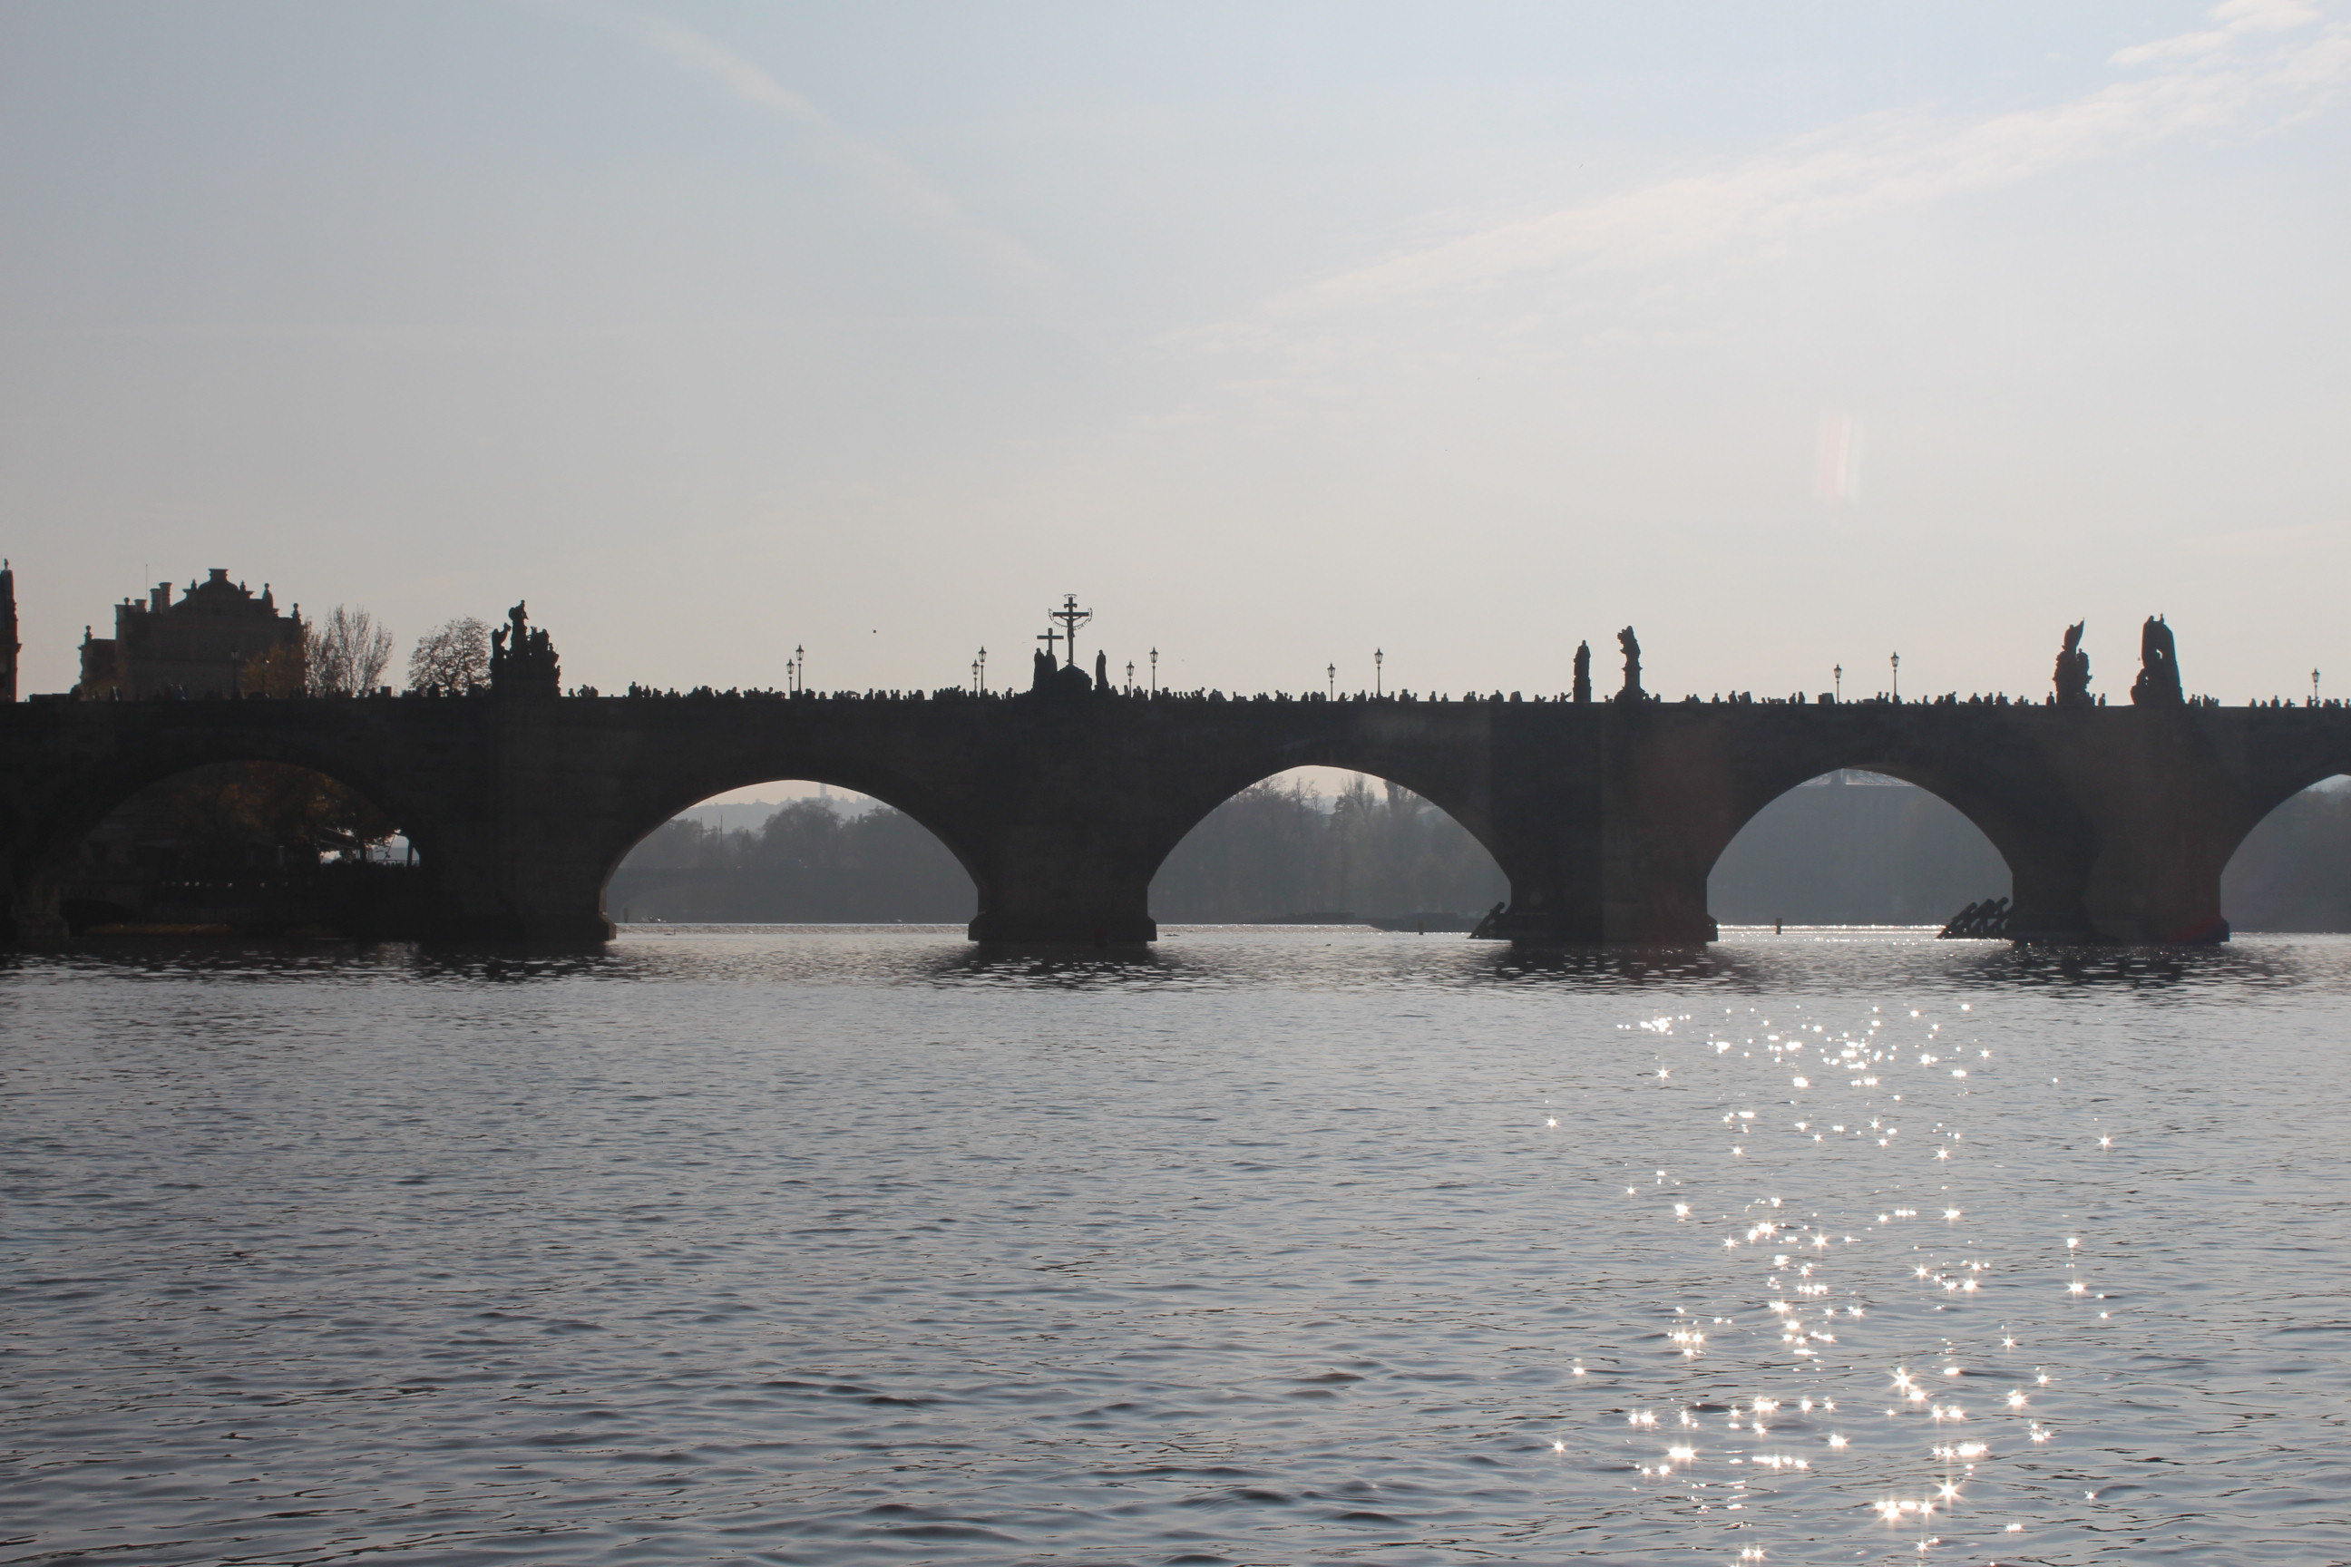
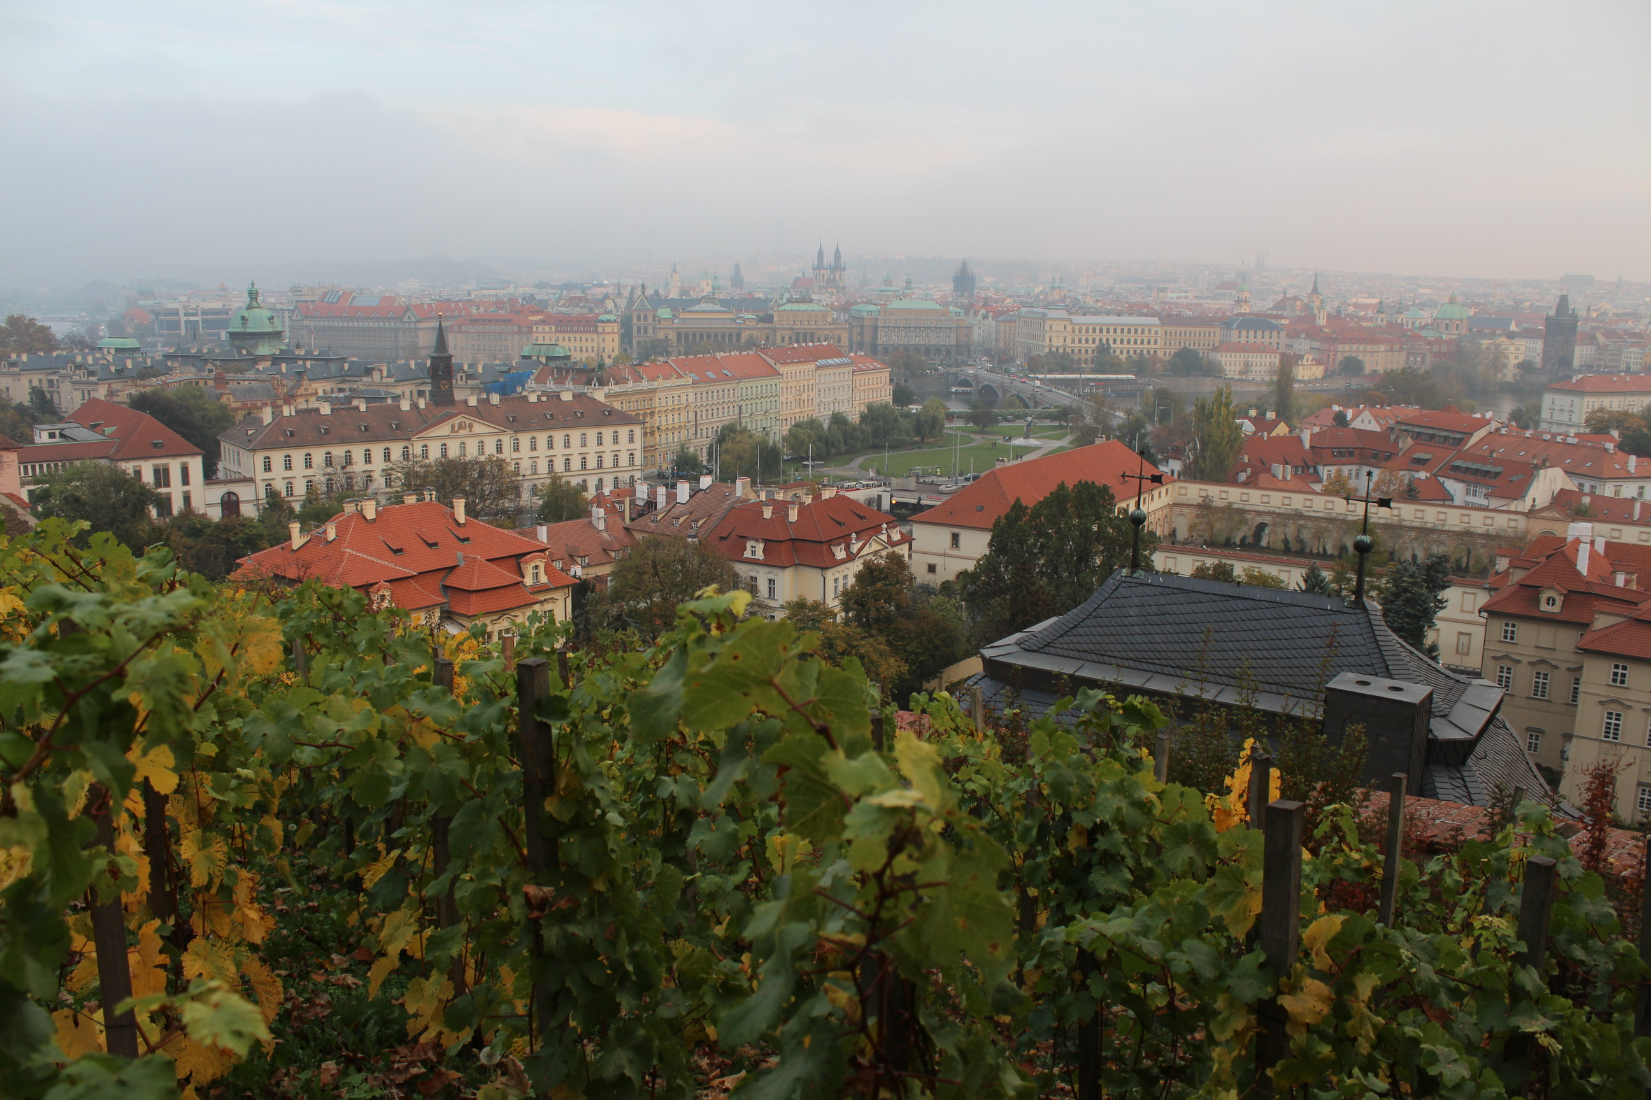
At the end of the day we evaluated the whole learning activity. We prepared the evaluation questionnaire and all participants filled it. Then we used the results for evaluation of this learning activity.

Slide 12
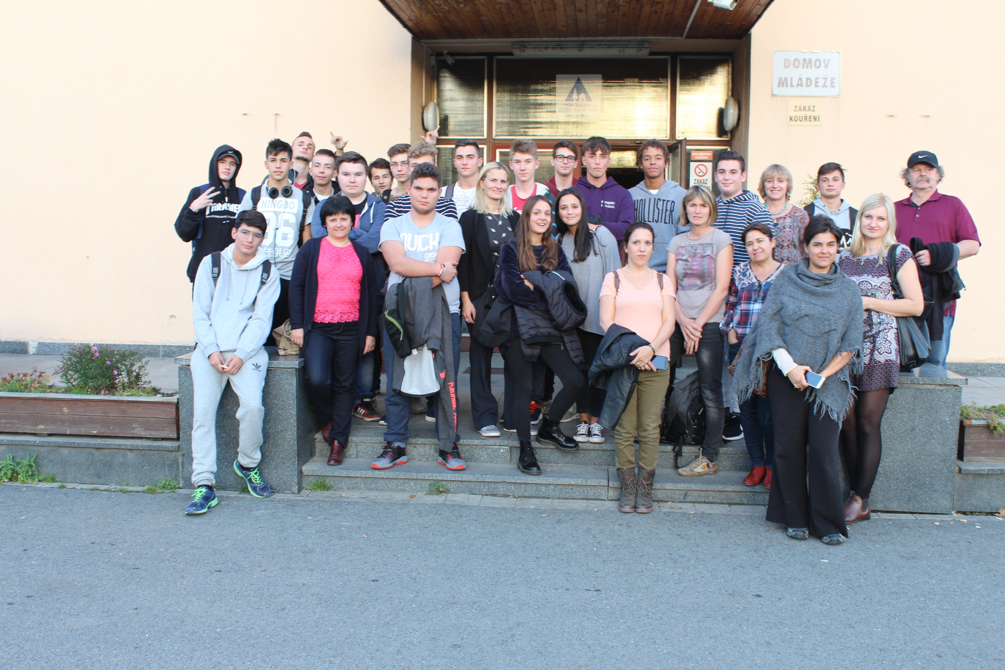
7th day October 21
We said goodbye to each other and all groups returned to their home countries.

